Slide 1


Multidisciplinary Surgical Management of Metastatic Ovarian Cancer: A Collaborative Experience Between General Surgery and Gynecology in a Multidisciplinary Referral Hospital
Dr. Michele Marini
ASST BERGAMO EST
OSPEDALE BOLOGNINI DI SERIATE
Direttore Dr. Antonio Piazzini Albani
Maggio 2026

Slide 2

Multidisciplinary Surgical Management of Metastatic Ovarian Cancer
Abstract
Background
Advanced and metastatic ovarian cancer frequently requires extensive cytoreductive surgery, often involving the gastrointestinal tract. Achieving complete cytoreduction while maintaining acceptable morbidity represents a major challenge and supports the need for a structured multidisciplinary surgical approach
Materials and Methods
We conducted a retrospective analysis of all consecutive patients with advanced ovarian cancer who underwent cytoreductive surgery with combined involvement of Gynecology and General Surgery at our multidisciplinary referral hospital in 2025.
A total of 16 patients were included. Median age was 67 years (range 49-82). According to FIGO classification, 4 patients had stage III disease and 6 patients stage IV.
Gastrointestinal involvement requiring bowel resection was present in 6 cases. Surgical procedures included rectosigmoid resection, colonic resection, and small bowel resection
Primary endpoints were completeness of cytoreduction (R0/R1), postoperative morbidity according to the Clavien–Dindo classification, and 30-day mortality.
Results
Complete macroscopic cytoreduction (R0) was achieved in 100% of patients. Major postoperative complications (Clavien–Dindo ≥ III) were not reported. Anastomotic leakage and 30 - days mortality were not recorded.
Conclusions
In a multidisciplinary referral hospital, a structured collaboration between Gynecology and General Surgery allows safe and effective management of metastatic ovarian cancer. This integrated surgical approach achieves high rates of complete cytoreduction with acceptable morbidity and supports its role as a standard strategy for complex ovarian cancer surgery in selected cases.

Slide 3
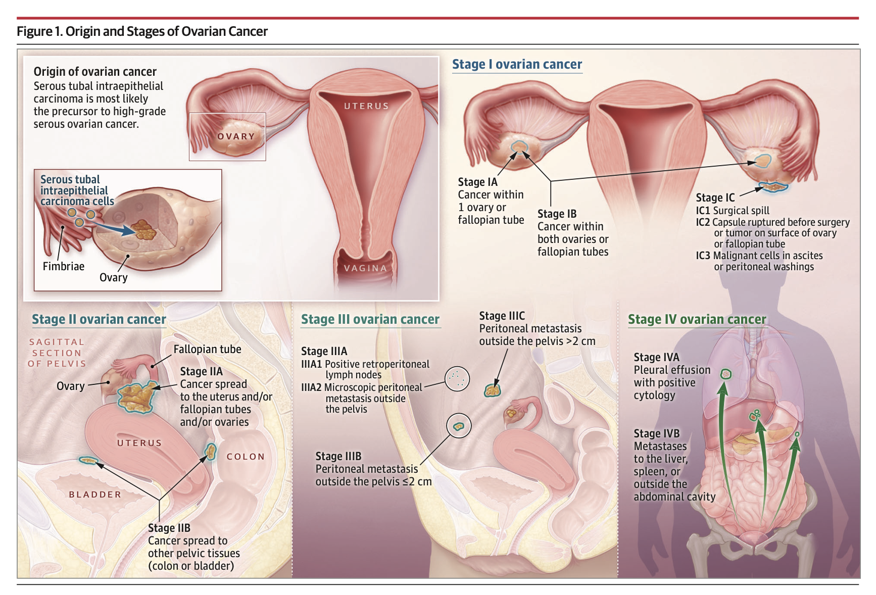
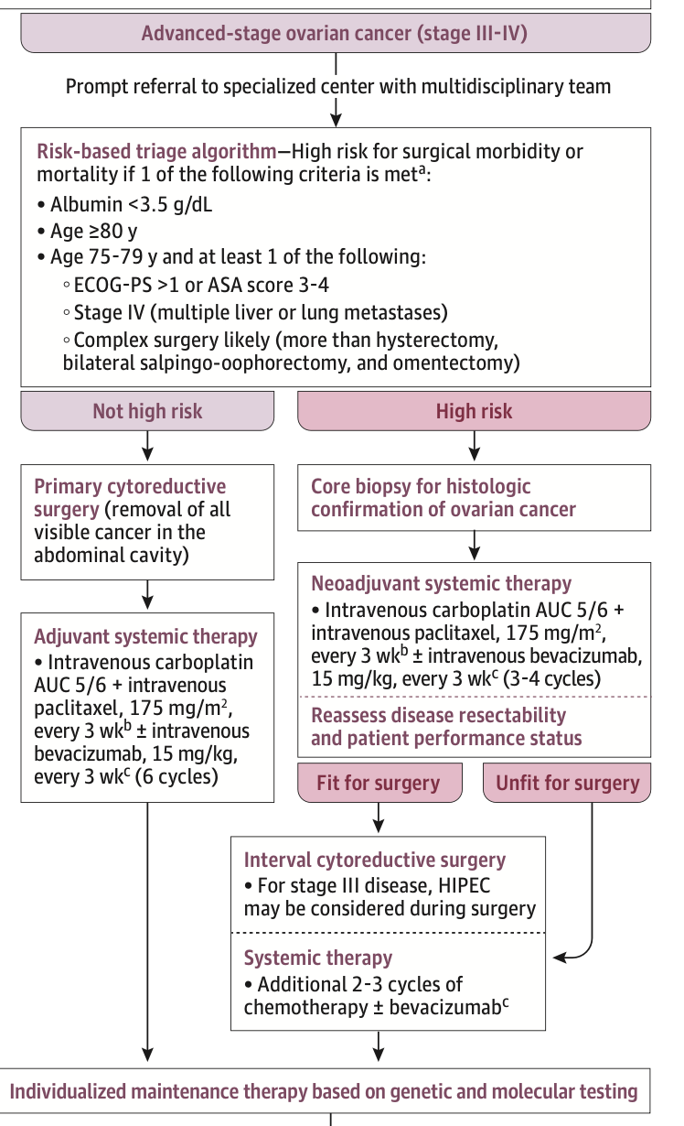
Multidisciplinary Surgical Management of Metastatic Ovarian Cancer
The Rationale for a Surgical Collaboration Between Gynecology and General Surgery

Slide 4
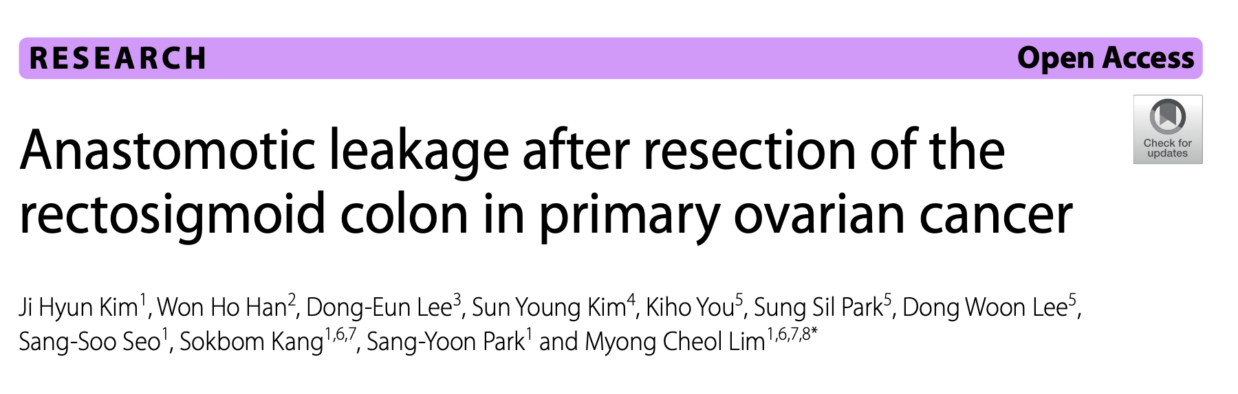

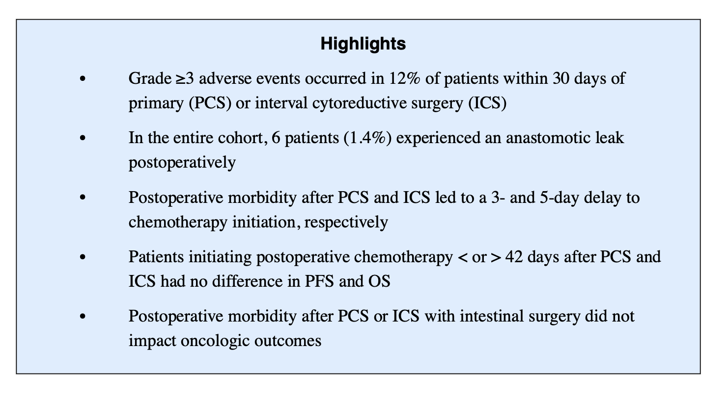
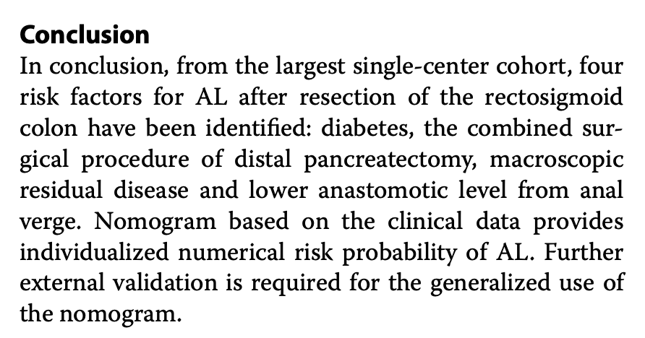
Multidisciplinary Surgical Management of Metastatic Ovarian Cancer

Slide 5

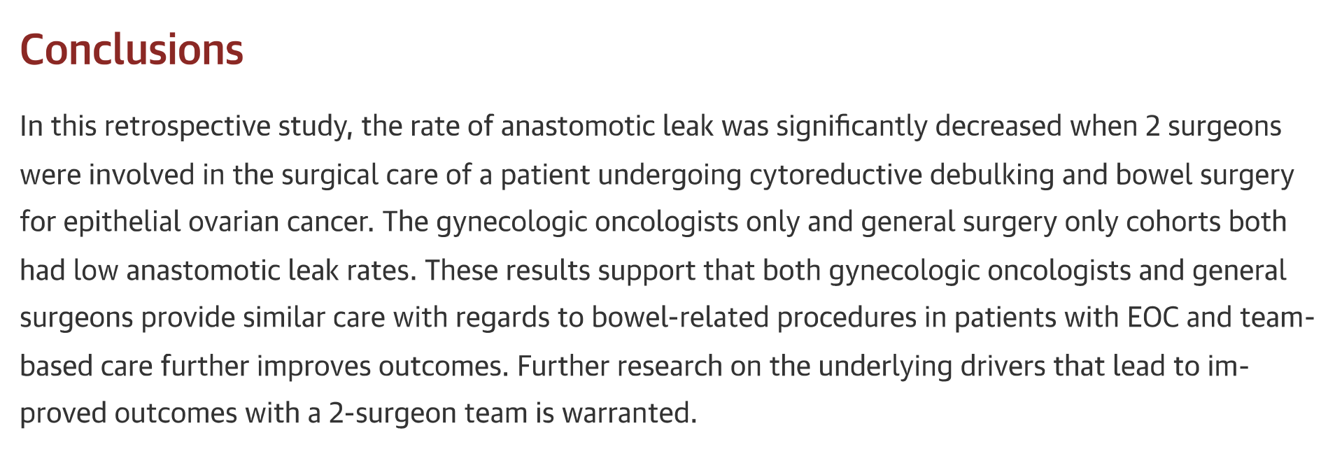

Multidisciplinary Surgical Management of Metastatic Ovarian Cancer
The Rationale for a Surgical Collaboration Between Gynecology and General Surgery

Slide 6

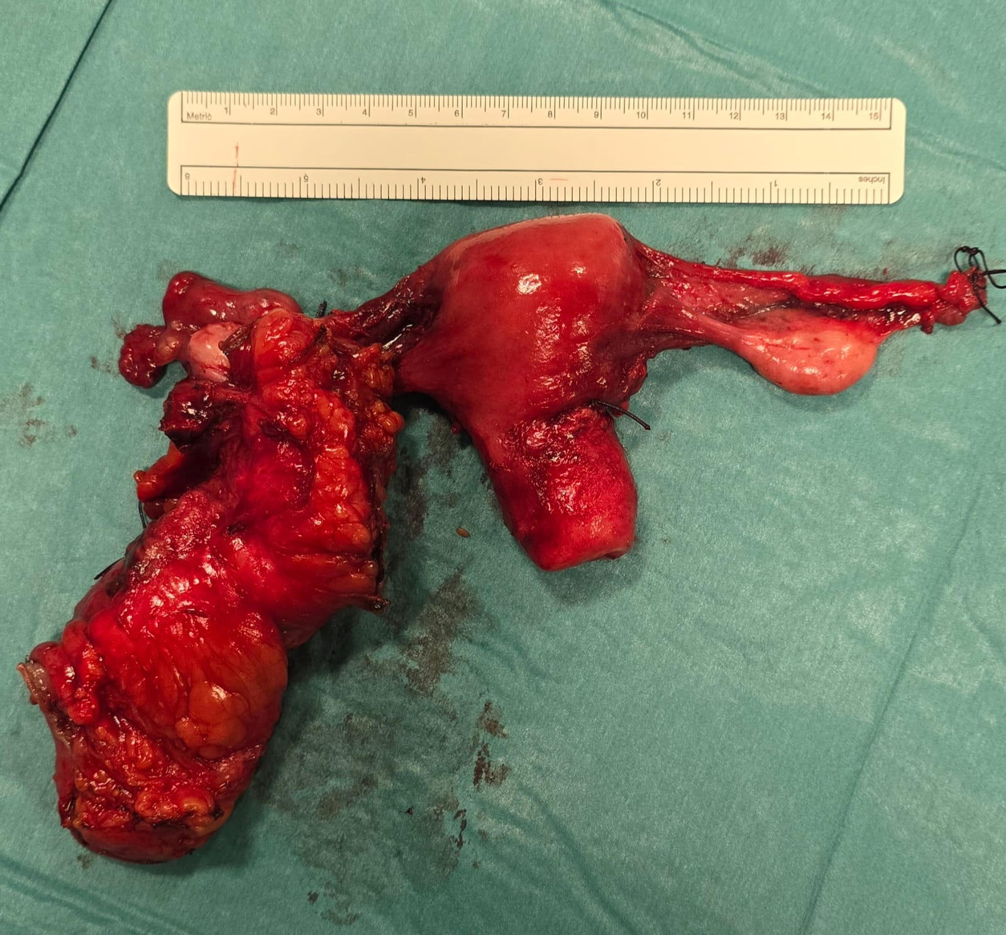
Multidisciplinary Surgical Management of Metastatic Ovarian Cancer
Of 16 patients, 6 were treated with a combined cytoreductive surgical approach.
Four patients underwent sigmoidectomy, of whom two had a protective ileostomy; one underwent ileal resection with right hemicolectomy and removal of diaphragmatic nodules; and one underwent sigmoidectomy combined with ileal resection.
All patients were classified as R0, with no severe postoperative complications (Clavien-Dindo > 3) and no 30-day mortality recorded.
Four postoperative cases of anemia requiring blood transfusion were recorded, as well as one case of infected ascites due to Staphylococcus, which was managed conservatively.

Slide 7
Multidisciplinary Surgical Management of Metastatic Ovarian Cancer
The Rationale for a Surgical Collaboration Between Gynecology and General Surgery
Comprehensive Preoperative Evaluation: All patients undergo dietitian consultation, colonoscopy, and gastroscopy, ensuring thorough assessment and optimization before surgery.
2. Multidisciplinary Planning: Cases are reviewed jointly by surgeons and gynecologists, allowing for coordinated decision-making on laparoscopic versus open surgical approaches.
3. Personalized Surgical Strategy: The combined input enables selection of the most appropriate surgical technique from the outset, reducing the need for intraoperative changes or staged procedures.
4. Improved Patient Outcomes: Integration of nutritional, endoscopic, and surgical evaluations minimizes complications, enhances recovery, and supports better overall clinical results.

Slide 8




