Slide 1
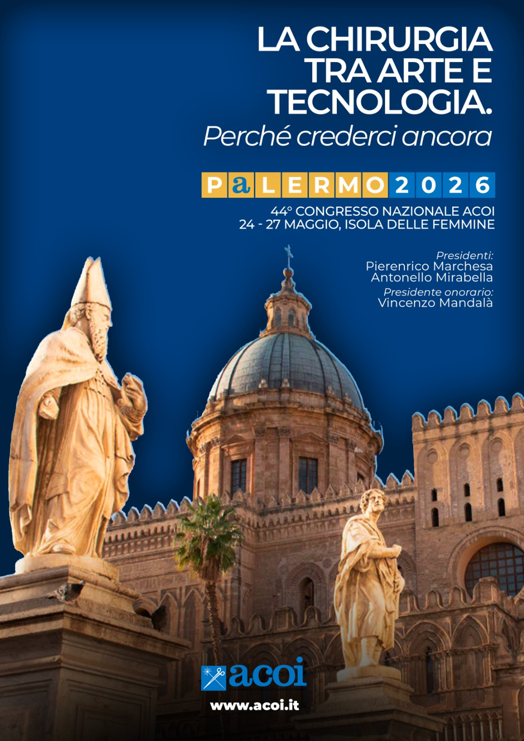

Acute Gallstone Ileus
Presenting as High Grade Small-Bowel Obstruction:
A case report
Carmen Amaranto
UOC Chirurgia Generale
Ospedale dei Castelli
X Maggio 2026

Slide 2
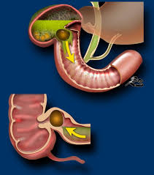

Acute Gallstone Ileus Presenting as High Grade Small-Bowel Obstruction: A case report
INTRODUCTION
Complication of cholelithiasis, and it is described as the presence of a mechanical biliary obstruction by impaction of large gallstones within the gastrointestinal tract.
0,095% OF SMALL BOWEL OBSTRUCTIONS [1]
1%-4% OF PATIENTS WITH GALLSTONES [2]
only 50% of patients have a previous history of biliary pathology[3]
surgical intervention remains critical[4]

Slide 3

CASE PRESENTATION
  WOMAN, 67 YEARS
  NEGATIVE HISTORY FOR PREVIOUS BILIARY COLIC
  NO PREVIOUS ABDOMINAL SURGICAL PROCEDURE
CLINICAL PRESENTATION
Pain
Vomiting
Abdominal distension

Slide 4
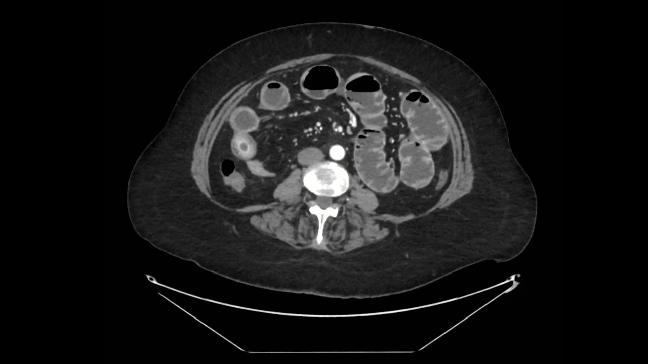

Slide 5
SURGICAL TREATMENT
1 STAGE SURGERY
enterolithotomy alone
enterolithotomy with concomitant cholecystectomy
2-STAGE SURGERY with delayed fistulectomy or fistula repair (4 W– 6 M)
the overall recurrence rates in the patients who had enterolithotomy only were relatively low [5]
cholecystectomy with fistula repair showed increased complications and increased length of hospitalization [6]

Slide 6

SURGICAL TREATMENT
      Patient underwent emergency surgical interventition
LAPAROSCOPY
ENTEROLITHOTOMY
Bowel function resumed regularly, and the patient was discharged home in stable clinical condition.

Slide 7
REFERENCES
1. Halabi, Wissam J. et al. Surgery for Gallstone Ileus: A Nationwide Comparison of Trends and Outcomes. Annals of Surgery 259(2):p 329-335, February 2014.
2. Vadher D. The Rolling Stones: A Systematic Review and Meta-Analysis of the Management of Gallstone Ileus. Chirurgia (Bucur). 2024 Oct;119(5):483-514.
3. Beuran M. et al. Gallstone ileus–clinical and therapeutic aspects. J Med Life. 2010;3:365–71.
4. Nuño-Guzmán C.M et al. Gallstone ileus, clinical presentation, diagnostic and treatment approach. World J. Gastrointest. Surg. 27 janv 2016;8(1):65–76.
5. Tan Y.M. et al. A comparison of two surgical strategies for the emergency treatment of gallstone ileus. Singapore Med J. 2004; 45(2):69-72
6. Doko M. et al. Comparison of surgical treatments of gallstone ileus: preliminary report. World J Surg. 2003;27(4):400-4.

Slide 8




