Slide 1


A standardized technique for laparoscopic total colectomy in acute severe ulcerative colitis:
a technical note
Carlo Alberto Manzo, MD
Struttura complessa di chirurgia generale
Ospedale di Circolo di Rho
Rho, Milano
X Maggio 2026

Slide 2
Background & Rationale
30% of UC patients require colectomy
ASUC = high-risk, time-sensitive surgery
High technical and anatomical complexity
Need for structured laparoscopic strategy
Key problem
👉 Lack of reproducible operative landmarks in ASUC

Slide 3
Aim & Surgical Concept
Standardized laparoscopic total colectomy
Based on Critical View of Safety
Two operative phases:
  Left colectomy
  Right + transverse colectomy
10 predefined critical views
📌 Designed for elective and emergency settings

Slide 5
Surgical video

Slide 6
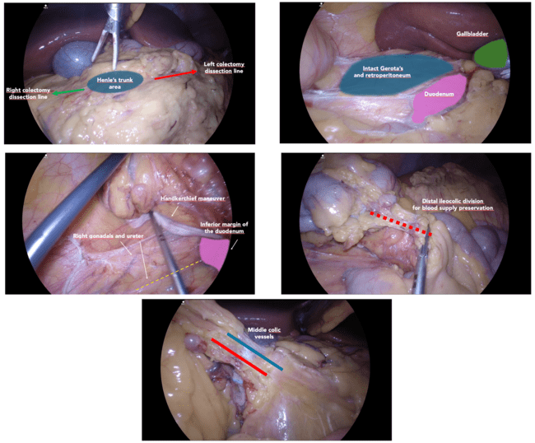

Slide 7
Technique & Results
49 consecutive patients (2020–2024)
Laparoscopic approach: 96%
Mean operative time: 160 min
1 rectal stump dehiscence
No intraoperative catastrophic events

Slide 8
Conclusions & Take-home messages
Standardization improves
    Anatomical orientation
    Intraoperative safety
    Teaching and reproducibility
Particularly valuable in high-risk ASUC surgery
Take-home message:
👉 Standardization is a safety tool, not a limitation

Slide 9




