Slide 1
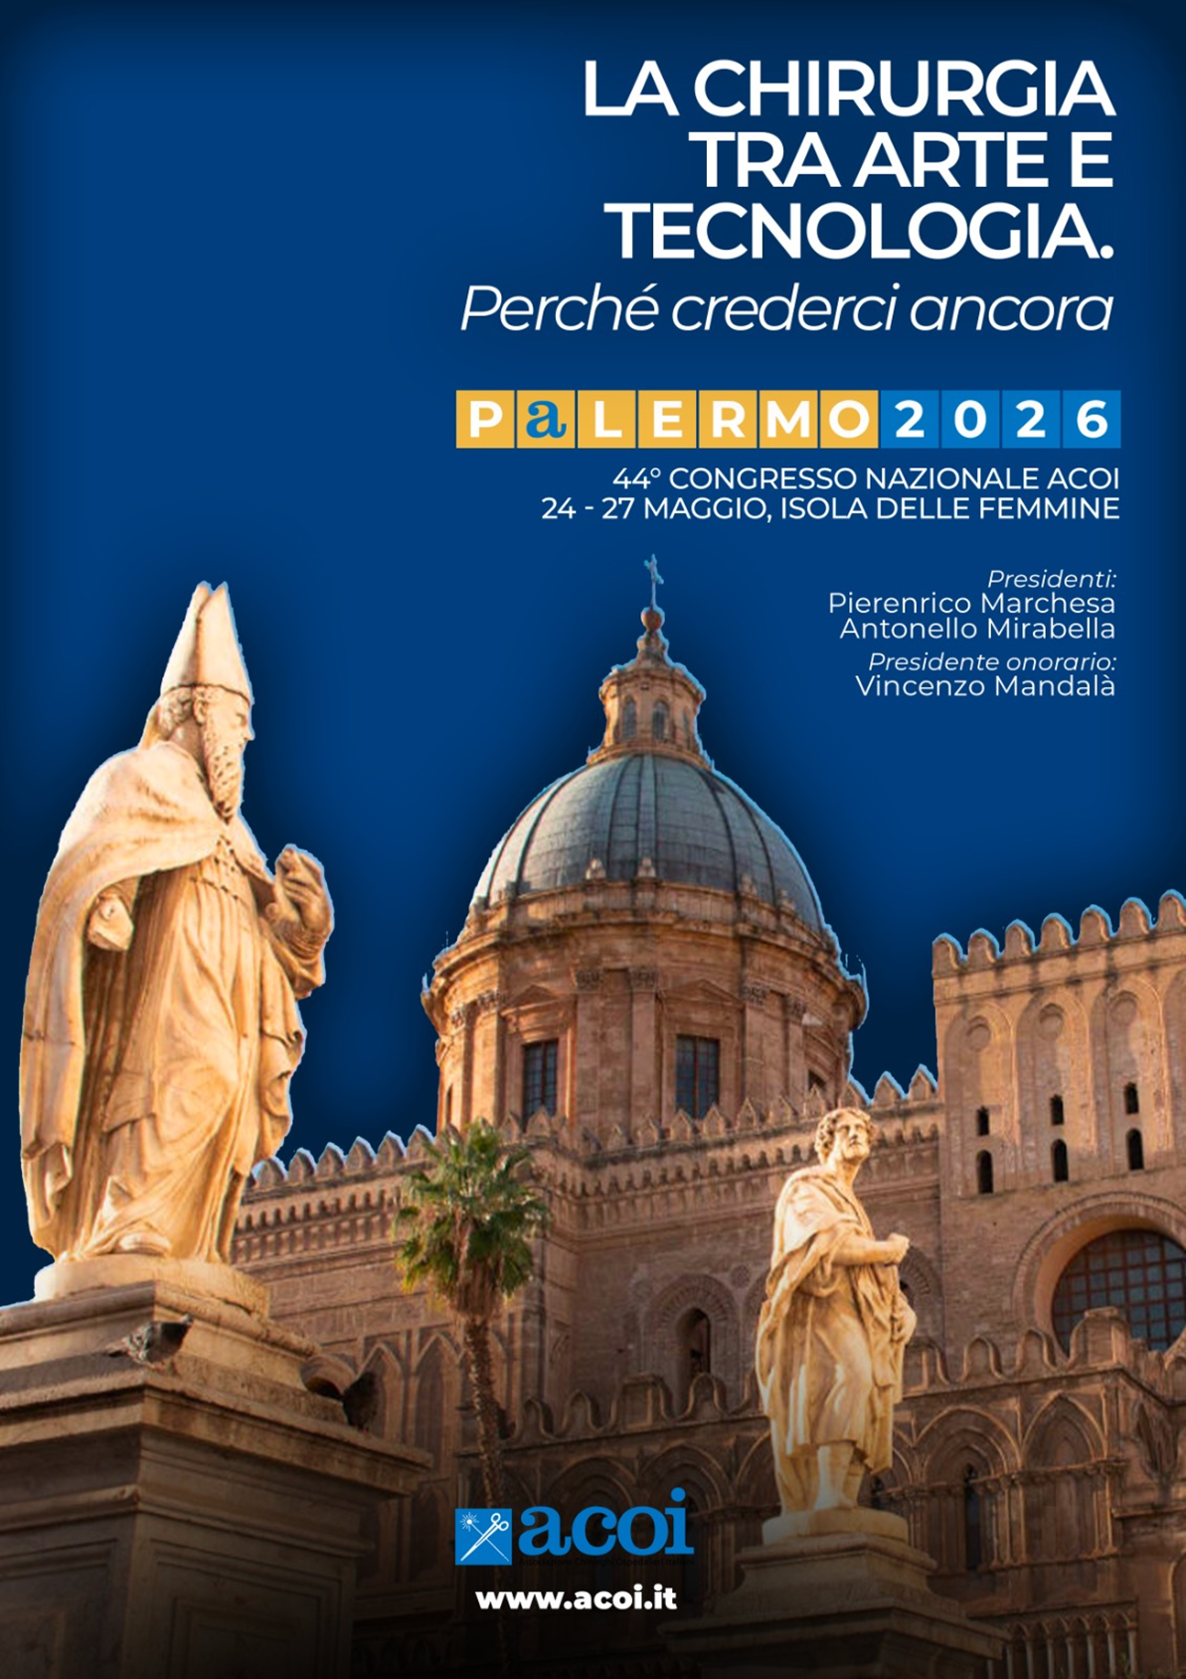

An unknown complication of a rare combination of intestinal invagination and Meckel’s diverticulum invaginated in an adult: A case report
Salvatore Ragazzi
UOC Chirurgia generale
Ospedale Guzzardi
Vittoria
X Maggio 2026

Slide 2

Introduction
Invagination is defined as two consecutive segments of the gastrointestinal tract intertwining into each other (1). In children, it is the second most common cause of acute abdominal pain after acute appendicitis, while it is rare in adults. It accounts for 0.02-0.003% of all hospital admissions and for 1-3% of intestinal obstructions that require surgery . Meckel’s diverticulum is the most common congenital malformation of the gastrointestinal tract (present in 2%–4% of population) due to persistence of the congenital vitello-intestinal duct. Invagination remains a rare condition in adults, representing 1% –3% of bowel obstructions and it is a different entity in adults than in children. It is the most common congenital anomaly of the gastrointestinal system, with a rate of 1-3%. It was first described by Fabricus Hildamus in 1598, and was defined embryologically by the German anatomist Johann Friedrich Meckel in 1809 . Most of them are asymptomatic; they are recognized when they complicate, and can present with diverticulitis, gastrointestinal bleeding, intestinal obstruction, perforation, or invagination. It is a true diverticulum, typically located on anti-mesenteric border, and contains all three coats of intestinal wall with its separate blood supply from the vitelline artery. This case demonstrates the utility of laparacopy in diagnosing an intussusception of the Meckel’s diverticulum. We wish to present this extremely rare case of intestinal invagination and Meckel ‘s diverticulum invaginated, which is the first one that we have encountered in our practise, along with the accompanying diagnostic and therapeutic issues and a review of the literature.

Slide 3
Presentation of case
We report the case of a 23-year-old man who was admitted to the emergency room due to a diffuse abdominal pain. He had crampy abdominal pain with food vomiting ,without fever. Abdominal distension, pain in mesogastrium ,right lower quadrant tenderness and rebound were present on the examination.There was no gas or feces discharge in the last 24 hours. In the anamnesis he reported surgery for hypertrophic pyloric stenosis at the age of two months .There was gas-liquid level on the direct abdominal radiography with ileal distension. Laboratory findings showed: white blood cell count 17100 mm3, hemoglobin 13.7 g/dl, hematocrit 42.8%, and C-reactive protein (CRP) < 2.90 mg/L. An abdominal ultrasonography (USG) revealed a thick, telescoping long intestinal segment with severe edema and no vascularization, located in the right lower quadrant with fluid dilation of the intestinal loops upstream. It was thought the mass might be a result of invagination. Abdominal computerized tomography (CT) scan showed “ in the pelvic area there is a predominantly fluid distention of an ileal loop in the bladder area in which some gas-liquid levels are appreciated and which, for a stretch of about 15cm, shows thickened walls and, in the right iliac fossa, this loop shows a " target "and with double border image and twisted aspect of its meso : ileal invagination ”. As the patient had extensive peritonitis findings, with the pre-diagnosis of obstruction as a result of invagination, surgery was decided. The exploratory laparoscopy revealed the presence of invagination of an extensive stretch of ileum (14 cm) and for the excessive fluid ditension of ileal loop the laparoscopy was converted in laparotomy. A midline incision was made. During the operation, it was observed that the invaginated ileum loop was too ischemic for reduction (Photo 1 and 2 ); therefore, the invaginated segment was resected and side-to-side ileoileal anastomosis was performed. At the opening of the operating piece we noticed the rarity of the clinical case : intestinal invagination and Meckel ‘s diverticulum invaginated. Microscopic examination disclosed an ectopic gastric mucosa with ischemic changes on the whole ileum examined and confirmed the macroscopic appereance of intestinal invagination and Meckel ‘s diverticulum invaginated ( Photo 3-5). The patient tolerated the procedure and the postoperative period was complicated from a partial iatrogenic thrombosis of the left humeral vein confirmed by upper limb ultrasound .The patient was discharged on the sixteen post-operative day.

Slide 4
Discussion
This case report presents the unusual case of intestinal invagination and Meckel ‘s diverticulum invaginated.. By reviewing the literature, we aim to identify the management of this variant.
Intestinal invagination is a common pathology amongst children, while it is a rare entity in adults. Ninety-five percent of invaginations occur in childhood . Invagination is responsible for 1-2% of adultonset intestinal obstruction[2]. The invagination shows itself frequently with complete obstruction findings, as acute abdominal pain, nausea and vomiting, as it may present with subacute and chronic findings, as a result of partial obstruction. In 24-42% of the studies, it was observed that it can produce symptoms of an abdominal mass [13]. Our case had abdominal pain of acute onset, with subsequent distension and nausea and vomiting. Ultrasonography (USG) is accepted as the most valuable noninvasive diagnostic tool in patients who are thought to have invagination. The findings of invagination on USG are as follows: soft tissue mass with 2.5-5 cm diameter, target sign, multiple concentric ring sign, “pseudokidney” sign, and the sandwich sign. The sensitivity, specificity and negative predictive value of USG for the diagnosis of invagination are 98-100%, 88% and 100%, respectively [14]. Although the gold standard for invaginations is CT, it provides 50- 80% diagnostic data (2). In our case, abdominal USG was performed for atypical abdominal pain, and the invagination image was seen. As the invagination was diagnosed with suspected clinic of progressing obstruction, imaging studies including abdominal USG and CT scan were performed under emergency conditions and revealed ‘target lesions’ suggestive of small bowel intussusception and free-fluid in the abdominal cavity. Intestinal invagination is a common pathology amongst children, while it is a rare entity in adults. Invaginations are classified as gastroduodenal, enteric, ileocecal, and colonic, according to their localizations [13,15].
MD is an intestinal diverticulum that results from incomplete obliteration of the most proximal portion of the vitelline or omphalo-mesenteric duct during the fifth week of fetal development [4]. The failure of closure of the duct can result in an umbilical fecal fistula, umbilical sinus, fibrous cord, enterocystoma, mesodiverticular band or MD (distal ductal closure) [5]. MD contains all the three intestinal layers. It contains heterotopic tissue in 50% cases. The heterotopic tissue is: gastric, pancreatic, jejuna, duodenal, colonic or hepatobiliary tissue [6,7]. It may remain clinically silent and incidentally be identified at autopsy or surgery, or it may mimic disorders such as peptic ulcer disease, appendicitis and Crohn’s disease. Adult invagination represents only 1%–3% of intestinal obstructions in adults and it is a different entity in adults than in children [8]. The main causes of invagination in adults are: carcinomas, polyps, strictures, benign tumors and idiopathic, MD and colonic diverticulum.MD is a congenital diverticulum, themost common age at presentation is 2 years. It is therefore the most common congenital abnormality of the gastrointestinal tract. MD was first described by Fabricus Heldanus in 1650 [9], then Levator in 1671 [10] and then Ruysch in 1730 [11]. However, the diverticulum bears the name of Johann Friedrich Meckel who described the embryology of a small bowel diverticulum in 1809 [12]. The most common invaginations are the enteric invaginations, and they account for more than half of the cases [15]. Our case also had ileoileal invagination and MD invaginated. Of the 80-90% of adult-onset invaginations, the etiologic factor can be revealed [15]. While a malignancy is usually the effective factor for the colonic type, the intestinal type generally includes an initial factor such as a polyp, ectopic pancreas or MD [14]. Our case also had MD as an initial factor . Pre-operative diagnosis of MD is usually not possible; abdominal USG and CT frequently show secondary changes. Diverticulitis is especially mistaken as acute appendicitis, and with this pre-diagnosis, it is determined peri-operatively [3,16]. The most frequent complication of MD in adults is small intestinal obstruction [17]. The obstruction may occur by several mechanisms, as intestinal or cecal volvulus over the strip that extends from the diverticulum to the abdominal wall, invagination, simple obstruction by the encircling of the intestine by the strip, internal herniation, and incarceration of the diverticulum into the inguinal hernia [17,18].

Slide 5
Discussion
The treatment for symptomatic MD is surgery. However, the pre-operative diagnosis is extremely difficult, because its symptoms overlap with those of many other diseases. Cases are generally operated with a pre-diagnosis of acute abdomen and are diagnosed peri-operatively [16,18]. Inverted MD was also an initial factor for invagination in our case, and with the inflammation and the ischemia, it caused acute abdomen.
The basic treatment of adult-onset invagination is surgery [19]. If intestinal nutrition is not compromised due to invaginations that occur post-operatively because of adhesions, de-invagination may be successful. In the case of non inflammatory invaginations with a known causative factor (MD, lipoma), recurrence may be prevented with enterotomy and polypectomy [2,15,19]. Barussaud et al. [19] attempted reduction in 25 patients in a study including 44 patients; they were successful in 14 cases, and they continued with limited resection. However, Begos et al. [15] suggested that in patients with inflammation and ischemia and colonic invagination, de-invagination might cause perforation; therefore, resection should be performed without reduction. In our case, de-invagination of the invaginated segment was attempted, but the inflamed and edematous MD prevented total reduction of the ileal segment. The inflamed and ischemic intestinal segment was resected,including the MD invaginated.
The resection of asymptomatic Meckel’s diverticulum remains controversial. As for symptomatic MD, surgical resection is the treatment of choice. It can be achieved either by the diverticulectomy or by the segmental bowel resection and anastomosis, especially when there is palpable ectopic tissue at the diverticular-intestinal junction, intestinal ischemia or perforation. In our case, segmental resection of the small intestine was performed.

Slide 6
Conclusion
The complications related with MD should be kept in mind in the pre-diagnosis in young patients presenting with acute abdomen and ileus. A good knowledge of the clinical findings of MD would facilitate the decision to operate and the timing of the surgery, thereby preventing problems such as misdiagnosis and increase in morbidity in patients with a pre-diagnosis of acute abdomen. Although intestinal invagination and Meckel ‘s diverticulum invaginated is extremely rare, general surgeons should be aware of the possibility of this presentation.

Slide 7




