Slide 1



GIANT OMENTAL CYST MIMICKING PELVIC NEOPLASIA:
A CASE REPORT
Brignone L. Gurguri M. Nesi D. Palazzo V. Pozzo G.
Chirurgia Generale
Ospedale S. Croce
Moncalieri (TO)
24-27 Maggio 2026

Slide 2


Clinical case
Presentation
Male patient
22 years
No previous surgery
No Significant comorbidities
Admitted to the E.R. for dysuria, fever, and generalized abdominal pain.
Blood tests were normal, no elevated inflammatory markers.
Abdominal ultrasound revealed a mild free pelvic effusion and a large central abdominal/pelvic mass.

Slide 3
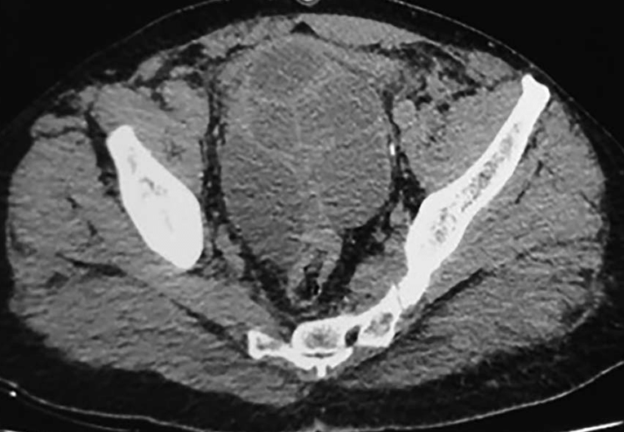

Diagnostic Path
Ca19.9 in range
CEA 35 ng/ml
Indication to esplorative laparoscopy

Slide 4
Surgical treatment
Video

Slide 5

Thank you for your attention

