Slide 1


Awake Major ColoRectal Surgery
for elderly frail patients
Case report
Biale CA., Batistotti P., D’Amato T.*, Amato A.
S.C. Chirurgia Generale - Ospedale di Imperia
*S.C. Anestesia e Rianimazione – Ospedale di Imperia
X Maggio 2026

Slide 2

Awake Major ColoRectal Surgery for elderly frail patients
Case report
Introduction
Awake surgery represent a further step forward in minimally invasive procedures with the aim of:
• minimizing surgical trauma
• optimazing patients’ post-operative recovery
      improving outcomes
We report a case of laparoscopic right hemicolectomy under neuraxial anaesthesia.

Slide 3

The Patient
80 years old ASA 4
Comorbidities:
                diabetes
                severe COPD
                atrial fibillation / pericardial effusion
                hypertension
                thyroid goiter
                previous spontaneous pneumothorax
                previous pulmunary lobectomy (bullous pulmonary emphysema)

Slide 4
The Patient
80 years old
BMI 24.8
Diagnosis ► Right Colon Cancer M0
Predictive scores ► fraility score, Ariscat score, NSQIP
ERAS prehabilitation

Slide 5
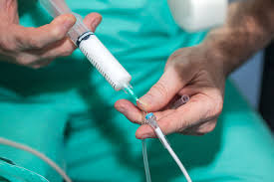
Anaesthesia
Sedation by Dexdor ev 0,3 - 1 gamma/kg/h
T6-T7 peridural catheter
T9-T10 spinal anaesthesia
Intraoperative monitoring ► MostCare, BIS
High fluxes ► FiO2 35%

Slide 6
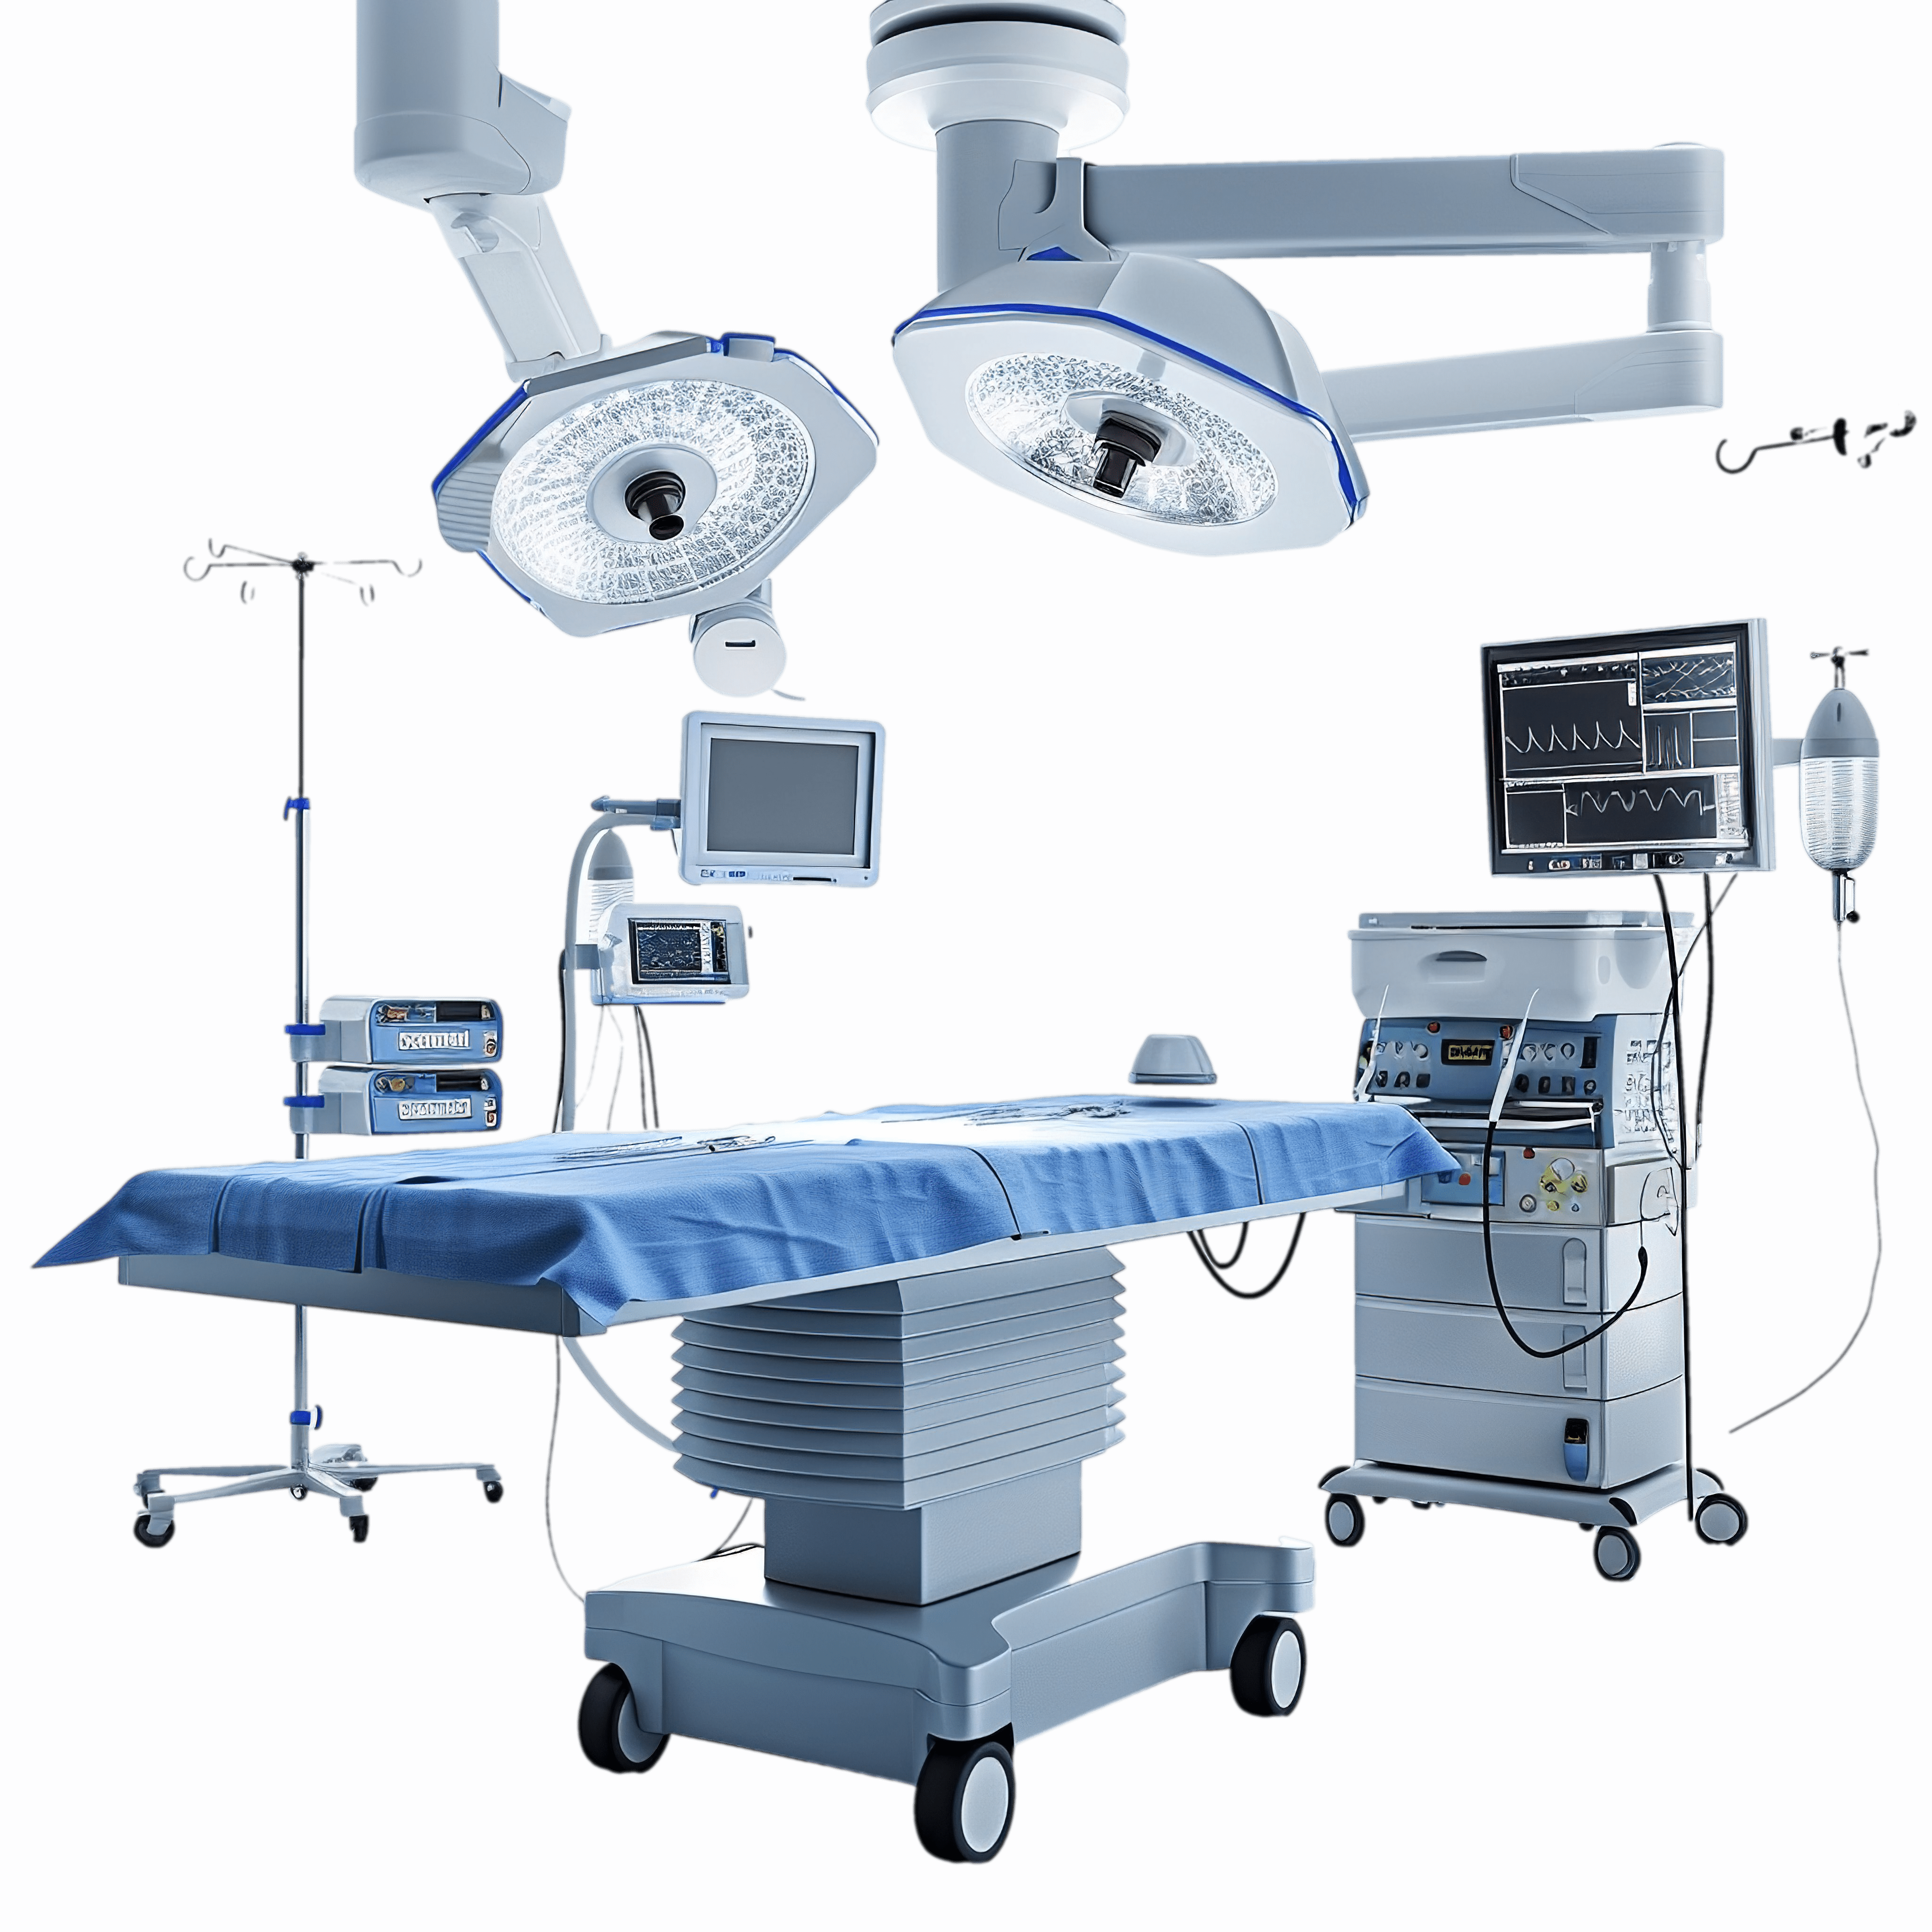
Surgery
Laparoscopic right hemicolectomy
Low-pressure pneumoperitoneum (8/10 mmHg)
Operating time: 120 min
First bowel movement: POD II
Uneventful postoperative course
Discharge: POD IV

Slide 7
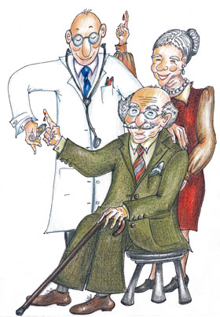
Conclusion
Awake laparoscopy surgery under neuraxial anaesthesia
could be performed safely in selected cases
Potential candidates:
• patients over 80 years old
• comorbidities
◦ neurocognitive decline
◦ severe respiratory diseases

Slide 8




