Slide 1


VOLUMINOUS RETROPERITONEAL SOFT TISSUE SARCOMA: A CASE REPORT
Dr. Lorenzo Guidotti, Dr.ssa Benedetta Vicentini, Dr.ssa Samantha Vellei, Dr. Paolo Moroni, Dr.Luca Romoli, Dr. Egidio Miranda, Dr. Stefano Cantafio
Usl Toscana Centro
Ospedale Santo Stefano
Prato
Maggio 2026

Slide 2

VOLUMINOUS RETROPERITONEAL SOFT TISSUE SARCOMA: A CASE REPORT
Soft tissue sarcomas are a heterogeneous group of tumors, rare in adults (approximately 1% of all neoplasms), but much more common in adolescents and young adults, accounting for approximately 10% of tumors in these age groups. [1] Specifically, retroperitoneal sarcomas account for approximately 10% of all sarcomas; they have a vague presentation, and diagnosis is often delayed: the most common symptoms include abdominal pain, changes in bowel habits, and increased abdominal circumference. [2]
[1] Kunisada T, Nakata E, Fujiwara T, Hosono A, Takihira S, Kondo H, Ozaki T. Soft-tissue sarcoma in adolescents and young adults. Int J Clin Oncol. 2023 Jan;28(1):1-11. doi: 10.1007/s10147-022-02119-7. Epub 2022 Jan 27. PMID: 35084598.
[2] Gamboa AC, Gronchi A, Cardona K. Soft-tissue sarcoma in adults: An update on the current state of histiotype-specific management in an era of personalized medicine. CA Cancer J Clin. 2020 May;70(3):200-229. doi: 10.3322/caac.21605. Epub 2020 Apr 10. PMID: 32275330.

Slide 3
VOLUMINOUS RETROPERITONEAL SOFT TISSUE SARCOMA: A CASE REPORT
Although radiological investigations are essential for guiding the diagnostic process, only biopsy allows confirmation of the nature of the lesion and its characterization among the hundreds of possible histological variants. [3] Due to the extreme histological variability of these diseases, many kinds of therapy are being considered, including radiotherapy, radioablation, and systemic therapy. [4-5] However, the cornerstone of treatment, as well as the definitive diagnostic tool, remains surgical excision of the lesion [6].
[3] Crombé A, Kind M, Fadli D, Miceli M, Linck PA, Bianchi G, Sambri A, Spinnato P. Soft-tissue sarcoma in adults: Imaging appearances, pitfalls and diagnostic algorithms. Diagn Interv Imaging. 2023 May;104(5):207-220. doi: 10.1016/j.diii.2022.12.001. Epub 2022 Dec 23. PMID: 36567193.
[4] Gervais MK, Basile G, Dulude JP, Mottard S, Gronchi A. Histology-Tailored Approach to Soft Tissue Sarcoma. Ann Surg Oncol. 2024 Nov;31(12):7915-7929. doi: 10.1245/s10434-024-15981-8. Epub 2024 Aug 22. PMID: 39174839.
[5] Alessandrini L, Sopracordevole F, Bertola G, Scalone S, Urbani M, Miolo G, Perin T, Italia F, Canzonieri V. Primary extragenital endometrial stromal sarcoma of the lung: first reported case and review of literature. Diagn Pathol. 2017 May 2;12(1):36. doi: 10.1186/s13000-017-0627-2. PMID: 28464838; PMCID: PMC5414122.
[6] Turgeon MK, Cardona K. Soft Tissue Tumors of the Abdomen and Retroperitoneum. Surg Clin North Am. 2020 Jun;100(3):649-667. doi: 10.1016/j.suc.2020.02.011. Epub 2020 Apr 15. PMID: 32402307.

Slide 4
VOLUMINOUS RETROPERITONEAL SOFT TISSUE SARCOMA: A CASE REPORT
We present the case of a 65-year-old woman who arrived at our emergency and admissions department with progressive abdominal distension. She underwent a contrast-enhanced abdominal CT scan, which revealed a mass measuring approximately 30 cm x 23 cm x 28 cm, occupying most of the abdominal cavity and displacing small bowel, pancreas, kidneys, and compressing the inferior vena cava.

Slide 5
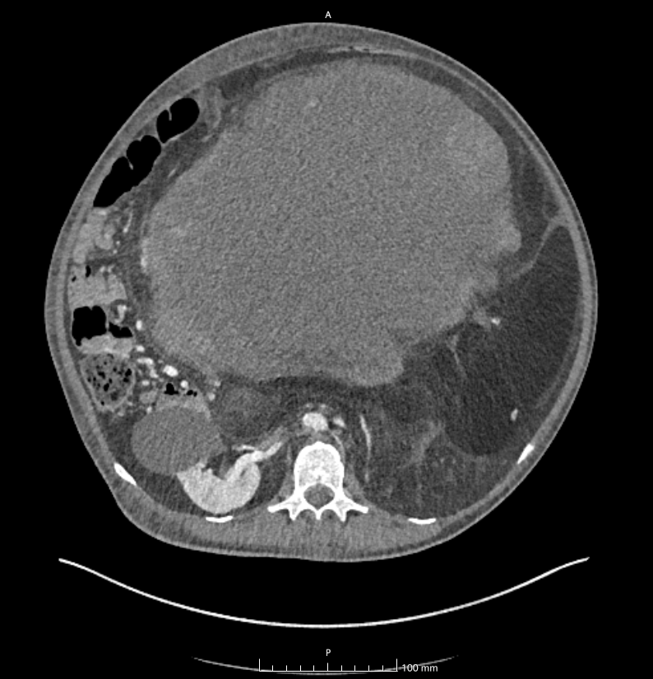
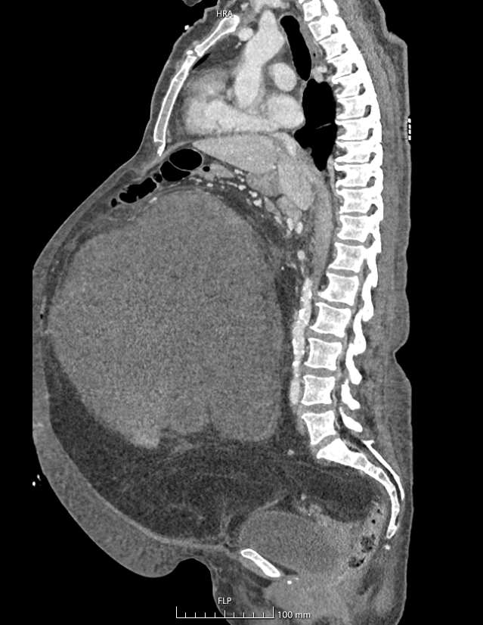
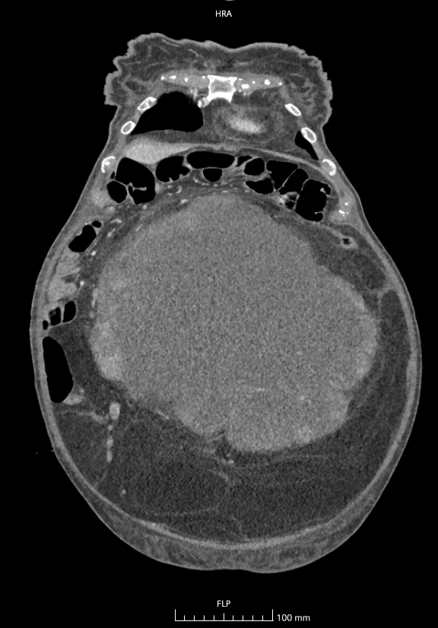
VOLUMINOUS RETROPERITONEAL SOFT TISSUE SARCOMA: A CASE REPORT

Slide 6
VOLUMINOUS RETROPERITONEAL SOFT TISSUE SARCOMA: A CASE REPORT
After the necessary tests and once the biopsy confirmed mesenchymal sarcoma, the patient underwent debulking surgery with left oophorectomy and left nephrectomy. Histological examination was positive for dedifferentiated retroperitoneal liposarcoma.
The postoperative course was uneventful. Due to the finding of ileal and pelvic nodularities on CT performed 45 days after surgery, systemic therapy was started (currently IV), well tolerated.

Slide 7





