Slide 1


Pylonidal Disease and laser surgery: our experience with SiLaC
Tagliabue F., Acerbis D., Bassi. F., Barbieri C.,
Salvetti F., Turati L., Mariani P.
Fabiana Bassi
S.C. Chirurgia Generale
ASST Bergamo Est
Ospedale "Pesenti-Fenaroli"
Alzano Lombardo (BG)
24-27 Maggio 2026

Slide 2
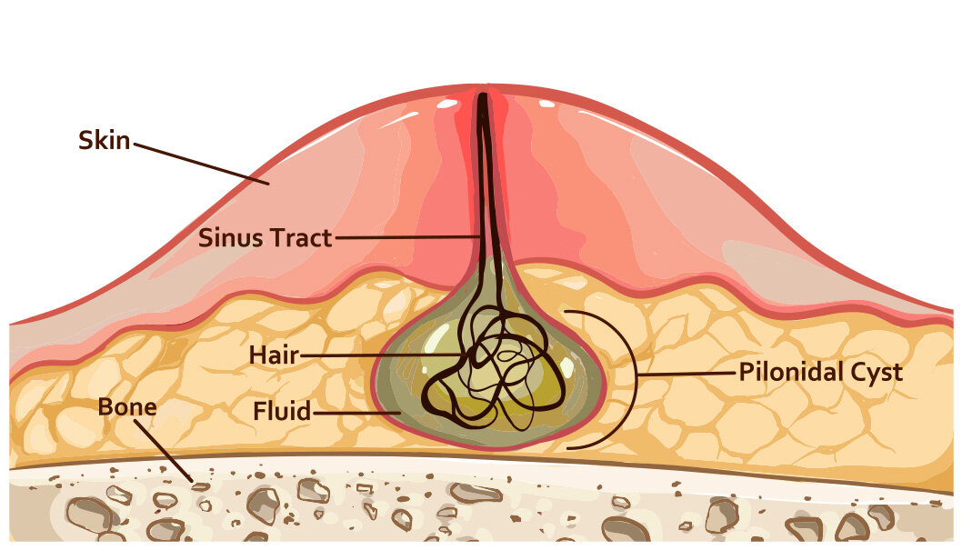

Pylonidal Disease and laser surgery: our experience with SiLaC
Main topic
A retrospective study was conducted to evaluate and report operative data and clinical outcomes about the laser-technique named Sinus Laser Closure (SiLaC) on patients with Pylonidal Disease (PD) treated at our Center.

Slide 3
Pylonidal Disease: epidemiology and diagnosis
The incidence of pilonidal sinus disease is estimated to be 26 per 100.000 people, more frequent among ages 15 to 30. Male gender, sedentary lifestyle, insufficient personal hygiene, and obesity are known potential risk factors.
Kanlioz M, Ekici U, Tatli F, Karatas T. Pilonidal Sinus Disease: An Analysis of the Factors Affecting Recurrence. Adv Skin Wound Care. 2021 Feb 1;34(2):81-85.
M. Ergenc And T. K. Uprak, "Gender-specific prevalence of sacrococcygeal pilonidal sinus disease in Turkey: A retrospective analysis of a large cohort," EUROPEAN SURGERY-ACTA CHIRURGICA AUSTRIACA, vol.55, no.1, pp.43-47, 2023
The diagnosis of PD is clinical, although anorectal examination or diagnostic imaging should be performed in case of PD near the anal verge, in order to rule out or to confirm the presence of other anorectal disease(s).
Milone M, et al.. Consensus statement of the Italian society of colorectal surgery (SICCR): management and treatment of pilonidal disease. Tech Coloproctol. 2021 Dec;25(12):1269-1280.

Slide 4
Classification: which one to use?
There is no validated classification of PD, even if sinus characteristics may modify surgical decision making and postoperative outcome. Features to be considered should cover: number of pits, their location in relation to midline, distance of the most caudal pits from the anal verge, and the presence of previous incisions or scars.
Milone M, et al.. Consensus statement of the Italian society of colorectal surgery (SICCR): management and treatment of pilonidal disease. Tech Coloproctol. 2021 Dec;25(12):1269-1280.
The current evidence supporting the different treatment options is limited by study quality with inconsistent characterization of disease severity and use of variable definitions and reporting of treatment-associated outcomes across studies.
Gil LA, Deans KJ, Minneci PC. Management of Pilonidal Disease: A Review. JAMA Surg. 2023 Aug 1;158(8):875-883.

Slide 5
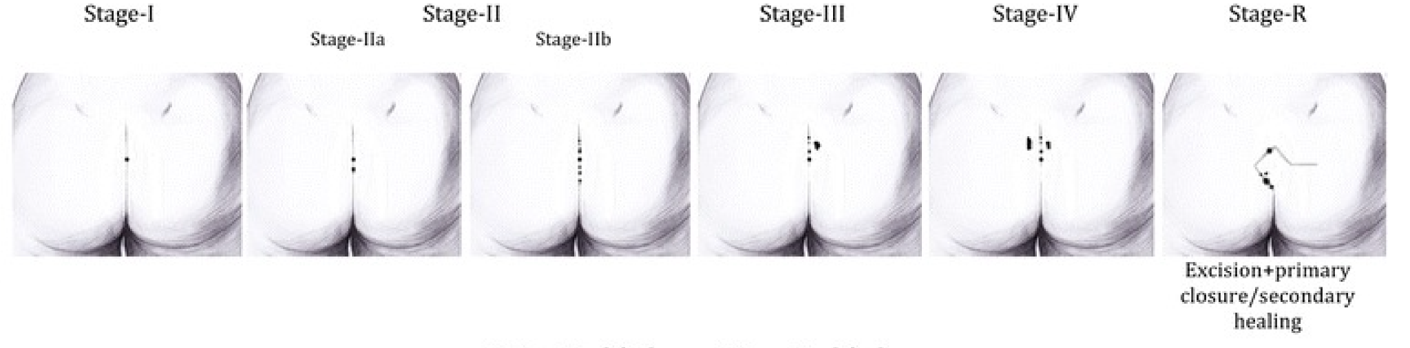
Classification: which one to use?
Stage I: single pit in the midline, no lateral extension; Stage III: midline pit/pits plus lateral extension in one;
Stage IIa: 2-3 pits in the midline; Stage IV: midline pit/pits + lateral extension in both directions;
Stage IIb: > 3 pits in the midline; Stage R: recurrent PSD following any type of treatment.
Guner A, Cekic AB, Boz A, Turkyilmaz S, Kucuktulu U. A proposed staging system for chronic symptomatic pilonidal sinus disease and results in patients treated with stage-based approach. BMC Surg. 2016 Apr 16;16:18.

Slide 6
Surgical approach: which is the most appropriate?
 | Closure type | Characteristics
Wide local excision | Primary | ↑ higher recurrence rate ↑ fast healing ↑↑ higher SSI rate
 | by secondary intention | ≈ medium recurrence rate ↓ late healing
 | flap use (Z-plasty, Limberg’s flap, Karydakis’s flap…) | ↓ lower recurrence rate ↑ fast healing ↓ lower SSI rate
Mini-invasive treatments | small circular incisions (Gibs technique) EPSiT (Bascom and Gibs technique) fibrin glue application phenol injection

Slide 7
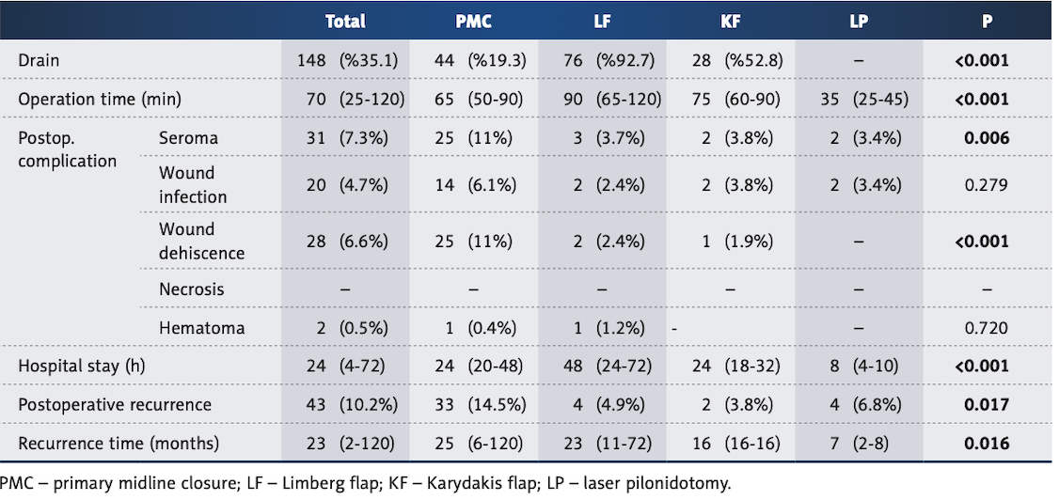
Problem: high rate of recurrence and complications
Recurrence-after excisional surgery is a common problem aftering 10-30% of patients.
Darnis B, et al. Management of pilonidal sinus and recurrences in 2025. J Visc Surg. 2025 Apr;162(2):117-127.
Gojayev A, et al. Comparative Outcomes of
Surgical Techniques for Pilonidal Sinus:
A Turkish Retrospective Study.
Med Sci Monit. 2025 Feb 25;31:e947466..

Slide 8
Mini-invasive laser treatment: Sinus Laser Closure
SiLaC® is a promising minimally invasive treatment for PD with high patient satisfaction and an acceptable success rate. These results suggest that SiLaC® could be used as a safe and effective primary treatment for PD.
Sluckin TC, et al. Sinus laser-assisted closure (SiLaC®) for pilonidal disease: results of a multicentre cohort study. Tech Coloproctol. 2022 Feb;26(2):135-141.
Laser ablation for pilonidal sinus disease is a new minimally invasive technique with good treatment efficacy, low postoperative recovery, and shorter recovery periods following employment.
Xie C, et al. Efficacy of Laser Treatment in Pilonidal Disease: A Single-Arm Meta-Analysis. Photobiomodul Photomed Laser Surg. 2024 May;42(5):375-382.
In a systematic review on pilonidal disease laser treatment consisting 971 patients, Romic et al. reported a primary healing rate of 94.4%, a weighted average recurrence rate of 3.8%, and a weighted average complication rate of 10%, most of which were mild.
Romic I, et al. Laser treatment of pilonidal disease: a systematic review. Lasers Med Sci. 2022 Mar;37(2):723-732.

Slide 9
Contraindications
Absolute contraindication
Acute pilonidal abscess.
Relative contraindications
Multiloculated or highly recurrent disease;
Coagulopathy;
Severe immunosuppression;
Inability to comply with postoperative care.
Ouali M, et al. International Society of Laser Proctology Position Paper on SiLaC and EPSiT/SiLaC in the Management of Pilonidal Sinus Disease. Lasers Surg Med. 2025 Dec;57(10):845-850.

Slide 10
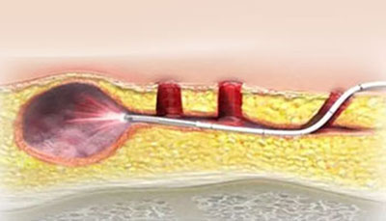
Surgical technique
In the SiLaC procedure, a 1470 nm 360° radial‐emitting laser fiber is advanced into each sinus tract and slowly withdrawn at ≈1 mm/s while delivering continuous laser energy.
The laser power should be individually chosen depending on the individual case, for example, low power like 8 watts for skinny patients and up to 10–12 watts for thick‐skinned and obese patients.
The laser energy induces photothermal ablation of the epithelial lining, protein denaturation, immediate cavity shrinkage, and tract obliteration, followed by secondary inflammatory remodeling.

Slide 11
Postoperative instructions
The patient was discharged on the same day of surgery (after 3 hours).
The patient was recommended to use analgesics (preferably paracetamol) if needed.
In the postoperative period, no special care was required other than press the tract, promote the discharge of secretions, and prevent premature closing of the skin

Slide 12
Our experience at “Pesenti-Fenaroli” Hospital, Alzano L.do
Luglio 2018 - Dicembre 2025
 | Patients [n] | Age [yearsi] | Sex |  | BMI [kg/m²] | Comorbidity
 |  |  | F [n(%)] | M [n(%)] |  | Diabetes | Hypertension | Dyslipidemia | Other
Overall | 220 | 28 ± 10 | 40 (18.2) | 180 (81.8) |  | 5 | 7 | 5
Stage I | 32 | 31 ± 14 | 5 (15.6) | 27 (84.4) | 25 | 1 | 3 | 0 | HBV (1), HCV (1), COPD (1), leukopenia (1)
Stage II | 118 | 27 ± 8 | 26 (22.0) | 92 (78.0) | 24 | 3 | 3 | 4
IIa | 83 | 27 ± 9 | 19 (22.9) | 64 (77.1) | 24 | 2 | 2 | 3 | COPD (1), autism (1), mental retardation (1)
IIb | 35 | 28 ± 8 | 7 (20.0) | 28 (80.0) | 25 | 1 | 1 | 1 | asthma (1)
Stage III | 33 | 28 ± 9 | 5 (15.2) | 28 (84.8) | 24 | 0 | 0 | 0
Stage IV | 9 | 33 ± 14 | 1 (11.1) | 8 (88.9) | 25 | 1 | 1 | 1
Stage R | 28 | 26 ± 9 | 3 (10.7) | 25 (89.3) | 26 | 0 | 0 | 0
Re-SiLaC | 18 | 26 ± 7 | 2 (11.1) | 16 (88.9) | 25 | 0 | 0 | 0
Traditional exeresis | 10 | 26 ± 14 | 1 (10.0) | 9 (90.0) | 27 | 0 | 0 | 0

Slide 13
Operative data
 | Patients[n] | O.R. occupancy [min] | Preparation [min] | Surgical time [min] | Anesthesia
 |  |  |  |  | Sedation | Local
Overall | 220 | 41 ± 13 | 16 ± 7 | 19 ± 9 | 4 | 216
Stage I | 32 | 33 ± 10 | 18 ± 7 | 12 ± 7 | 1 | 31
Stage II | 118 | 40 ± 13 | 15 ± 7 | 19 ± 8 | 1 | 117
IIa | 83 | 40 ± 13 | 15 ± 7 | 19 ± 9 | 1 | 82
IIb | 35 | 39 ± 10 | 16 ± 7 | 19 ± 7 | 0 | 35
Stage III | 33 | 43 ±11 | 17 ± 7 | 20 ± 6 | 1 | 32
Stage IV | 9 | 56 ± 14 | 21 ± 15 | 32 ± 14 | 0 | 9
Stage R | 28 | 47 ± 16 | 17 ± 7 | 24 ± 11 | 1 | 27
Re-SiLaC | 18 | 52 ± 16 | 19 ± 6 | 26 ± 13 | 0 | 18
Traditional exeresis | 10 | 32 ± 12 | 14 ± 9 | 19 ± 7 | 1 | 9

Slide 14
Post-operative outcomes (1)
 | Patients [n] | Regular course [n(%)] | 2-month persistent fistula [n(%)] | p-value
Overall | 220 | 194 (88.2) | 26 (11.8) | 0.146
Stage I | 32 | 31 (96.9) | 1 (3.1)
Stage II | 118 | 103 (87.3) | 15 (12.7)
IIa | 83 | 72 (86.7) | 11 (13.3)
IIb | 35 | 31 (88.6) | 4 (11.4)
Stage III | 33 | 30 (90.9) | 3 (8.1)
Stage IV | 9 | 6 (66.7) | 3 (33.3)
Stage R | 28 | 24 (85.7) | 4 (14.3)
Re-SiLaC | 18 | 15 (83.3) | 3 (16.7)
Traditional exeresis | 10 | 9 (90.0) | 1 (10.0)

Slide 15
Post-operative outcomes (2)
 | Patients [n] | Complete healing [n(%)] | Recurrence [n(%)] | Follow-up [months] | p-value
Overall | 220 | 200 (90) | 20 (10) | 27 ± 16.1
Stage I | 32 | 31 (96.9) | 1 (3.1) | 29 ± 14.5 | 0.187
Stage II | 118 | 109 (92.4) | 9 (7.6) | 27 ± 17
IIa | 83 | 77 (92.8) | 6 (7.2) | 26 ± 16.9
IIb | 35 | 32 (91.4) | 3 (8.6) | 27 ± 11.6
Stage III | 33 | 30 (90.1) | 3 (9.9) | 33 ± 12.9
Stage IV | 9 | 7 (77.8) | 2 (2.2) | 19 ± 13.8
Stage R | 28 | 23 (82.1) | 5 (7.9) | 23 ± 16.3
Re-SiLaC | 18 | 16 (88.9) | 2 (1.1) | 23 ± 14.3
Traditional exeresis | 10 | 7 (70) | 3 (30) | 24 ± 20.5

Slide 16
Post-operative outcomes (3)
 | Patients [n] | Complete healing [n(%)] | Recurrence [n(%)] | p-value
Overall | 220 | 200 | 20
Only laser treatment (stage I-II-III-IV-R laser) | 210 | 193 (91.9) | 17 (8.1) | <0.05
Stage R open | 10 | 7 (70) | 3 (30)

Slide 17
Post-operative outcomes (4)
 | Patients [n] | Completer healing [n(%)] | Recurrence [n(%)] | p-value
Overall | 220 | 200 (90) | 20 (10)
2-months persistent fistula | 26 | 17 (65.4) | 9 (34.6) | <0.001
Regular course | 194 | 183 (94.3) | 11 (5.7)

Slide 18
Conclusions
Easily reproducible
Mini-invasive technique
Shortens operative times
Fast return to daily activities
Simplified post-operative management
Good results in SiLaC as first line treatment
Late closure with fistulas (2-months) is associated with higher recurrence rate

Slide 19




