Slide 1


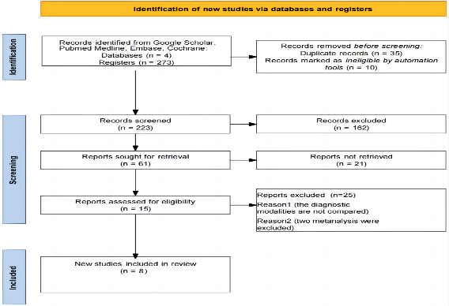
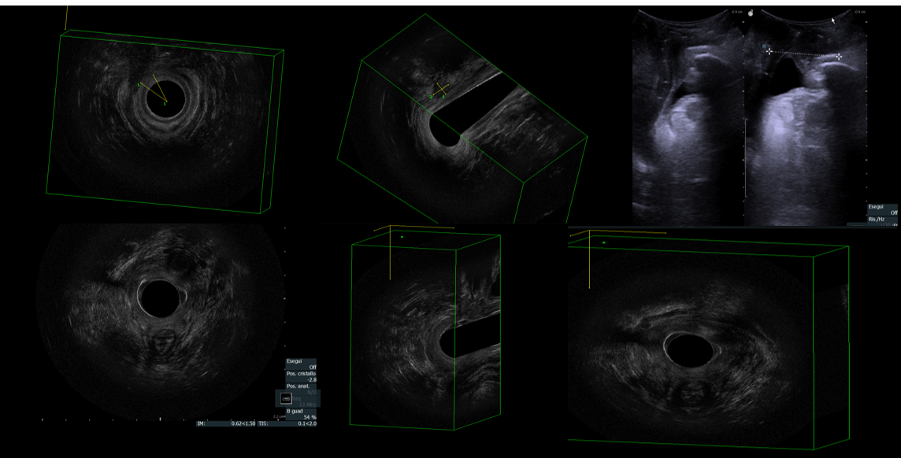
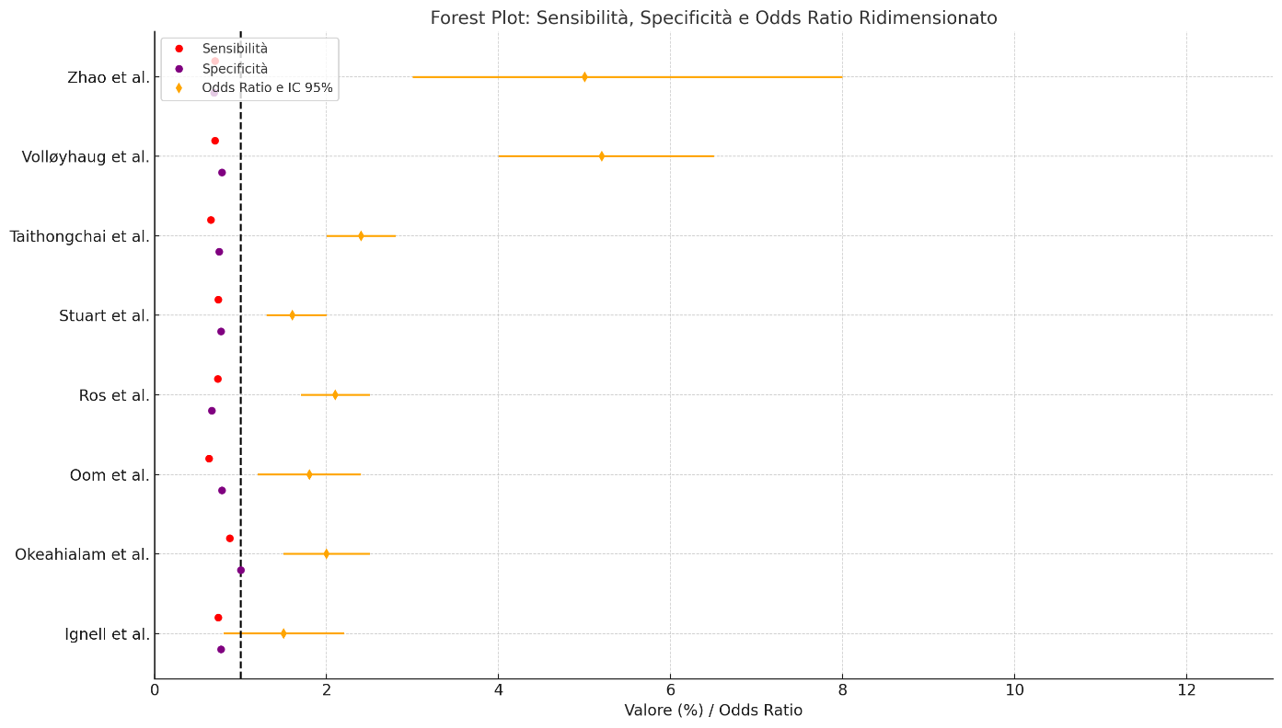
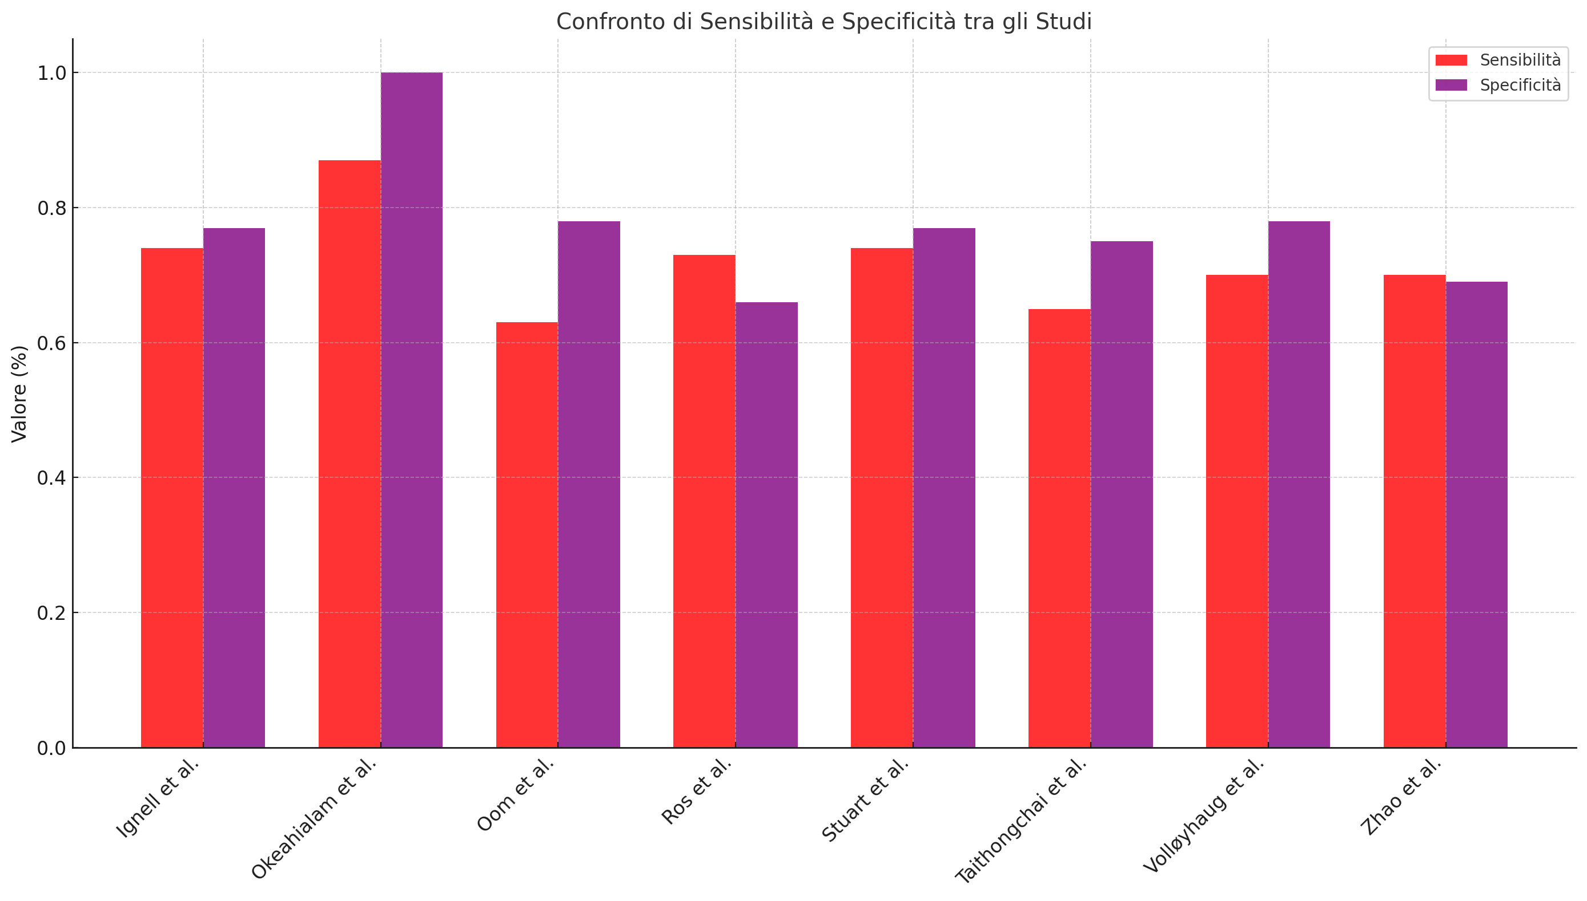
COMPARATIVE ANALYSIS OF TRANSPERINEAL, ENDOVAGINAL AND ENDOANAL
ULTRASOUND IN THE DIAGNOSIS OF OASIS: SYSTEMATIC REVIEW AND MONOCENTRIC EXPERIENCE
Nola V.¹, De Nardi P.², Pacilè V.¹, Cantarella S.¹, Baldini E.¹
¹General Surgery Unit, ASST Melegnano e Martesana, Presidio di Melzo, Milan,² Department of Gastrointestinal Surgery, IRCCS San Raffaele Scientific Institute, Milan
INTRODUCTION
PRISMA2020 Flow Diagram
RESULTS
Obstetric anal sphincter injuries (OASIS) are frequently underdiagnosed complications of vaginal delivery and may lead to long-term functional and psychological consequences. Early identification through ultrasound imaging allows prompt initiation of targeted pelvic floor rehabilitation. Endoanal ultrasound (EAUS) is regarded as the diagnostic gold standard, while transperineal (TPUS) and endovaginal (EVUS) approaches are emerging as viable alternatives, particularly in obstetric contexts.
EAUS showed the highest diagnostic accuracy (sensitivity 88%, specificity 75%), followed by TPUS (83% and 50%) and EVUS (75% for both). Lesions mainly affected the external anal sphincter (75%) and less often the internal sphincter (50%). According to RCOG classification, 6 cases were type 3a and 6 type 3b. Reported symptoms included fecal urgency (73%), gas incontinence (67%), and liquid stool leakage (47%), with a mean Wexner score of 6.4 Â± 3.9. Significant correlations emerged between Wexner scores and defects identified by EAUS (rho= 0.791), TPUS (rho = 0.730), and EVUS (rho= 0.648). Agreement between EAUS and TPUS was moderate (k= 0.47). Only EAUS showed a strong correlation between Starck and Wexner scores (rho= 0.805;rho= 0.0015).
CONCLUSIONS
EAUS remains the most sensitive and clinically reliable method for assessing OASIS. TPUS and EVUS, though less specific, are valuable tools. An integrated ultrasound approach supports early diagnosis and tailored rehabilitation.
OBJECTIVES
This study compared the diagnostic performance and clinical correlation of these techniques, focusing on the association with symptoms assessed using the Wexner score.
Parametro | Struttura | 3D-EAUS | 3D-EVUS | 2D-TPUS
Starck score | - | 3.08±3.34 | 3.92±2.91 | 3.11±3.59
Lenght | EAS | 0.75±0.75 | 0.73±0.47 | 0.42±0.73
 | IAS | 0.25±0.45 | 0.58±0.67 | 0.50±0.53
Depth | EAS | 0.83±0.83 | 0.75±0.62 | 0.42±0.73
 | IAS | 0.42±0.79 | 0.67±0.78 | 0.58±0.71
Angle | EAS | 0.58±0.51 | 0.75±0.75 | 0.18±0.44
 | IAS | 0.25±0.45 | 0.50±0.52 | 0.78±0.97
Dati espressi come media ± deviazione standard. Confronto delle tecniche ultrasonografiche rispetto al gold standard rappresentato dalla ecografia endoanale (EAUS) tridimensionale (3D).
REFERENCES
MATERIALS AND METHODS
Santoro GA, Wieczorek AP, Dietz HP, Mellgren A, Sultan AH, Shobeiri SA, et al. State of the art: an integrated approach to pelvic floor ultrasonography. Ultrasound Obstet Gynecol. 2011;37:381–96.
2. Wieczorek AP, Stankiewicz A, Santoro GA, Wozniak MM, Bogusiewicz M, Rechberger T. Pelvic floor disorders: role of new ultrasonographic techniques. World J Urol. 2011;29:615–23.
A systematic review following PRISMA guidelines was integrated with a monocentric prospective study involving 12 patients who delivered vaginally at Melzo Hospital between April and September 2024. Patients (mean age: 30.3 years) underwent EAUS, TPUS, and EVUS at 3 and 6 months postpartum in a single session. Sphincter defects, defined as greater than 30° discontinuities, were graded using the Starck score.
Figure 1. Forest plot of included studies: sensitivity (red dots), specificity (purple dots), and odds ratio with 95% CI (orange diamonds). The vertical line (OR = 1) is the reference.
Figure 2. Bar chart of sensitivity (magenta) and specificity (light pink) by study, showing balance or discrepancies between the two measures.
Tecnica | N | Sn (%) | Sp (%) | PPV (%) | NPV (%) | Κ
EAUS | 12 | 88 | 75 | 88 | 75 | 0.67
EVUS | 12 | 83 | 50 | 63 | 57 | 0.33
TPUS | 12 | 75 | 75 | 85 | 60 | 0.47
EAUS endoanal ultrasound; EVUS endovaginal ultrasound; TPUS transperineal ultrasound; PPV positive predictive value; NPV negative predictive value; κ indice di concordanza di Cohen.
ACKNOWLEDGEMENT
I am grateful to Dr. P. De Nardi for her expert guidance in pelvic ultrasound, the San Raffaele Hospital for research resources, and Dr. Luigi Caputo and Dr. Giuseppe Losa (Obstetrics & Gynecology, Melzo Hospital) for patient data and collaboration

