Slide 1
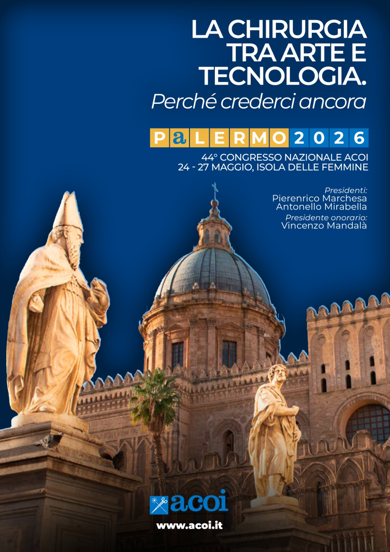

Endoscopic closure of gastric perforation due to abuse of FANS after failure of surgery
Dr. P. SALLUSTIO, Dr. F. Zippo, Dr.ssa G. Fanelli
Università degli Studi di Bari “A. Moro” – Regione Puglia
Azienda Ospedaliero – Universitaria Consorziale Policlinico di Bari
Unità Operativa Complessa di Chirurgia Generale Universitaria “V. Bonomo”
Direttore: Prof. Mario Testinià
24-27 Maggio 2026

Slide 2
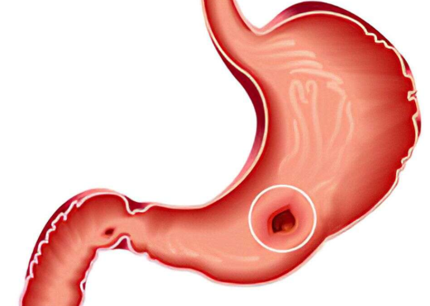

Primary endoscopic closure of a perforated gastric wall during endoscopic procedures is mostly effective and well-tolerated; however, there are very few studies on the efficacy of endoscopic management of delayed gastric perforation. Herein, we report a novel case of a patient who was successfully treated for delayed stomach perforation using endoscopic modality.

Slide 3
Case report
P.G. male 67 y OSAS,BCPO,OBESITY, FANS ABUSE
26/12/2025: surgical raphya of stomac perforation.
26/12/2025: intensive care admission
08/01/2026: surgical tracheostomy
10/01/2026: Metilen blu ingection through gastric tube and finding of blu into the drainage. Conservative treatment and drainage of abdominal collection.
15/01/2026: CT SCAN: Pesistence of gastric perforation.
16/01/2026: endoscopic attempt of gastric repair perforation

Slide 4
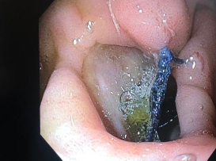
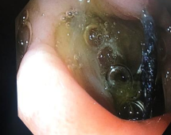
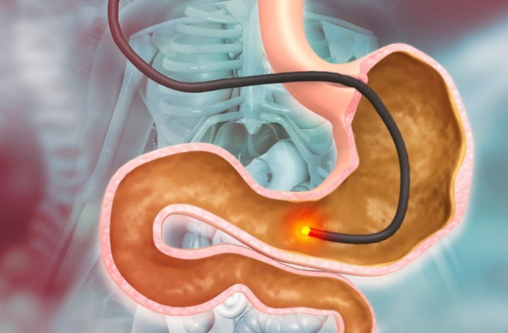
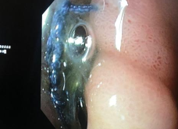
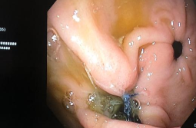
EGDS: evidence of suture at the upper surface of the gastric antrum and persistence of gastric perforation

Slide 5
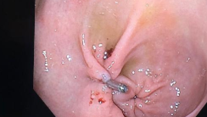
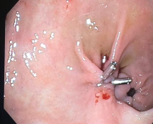
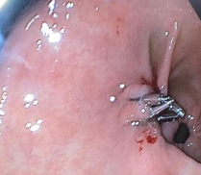
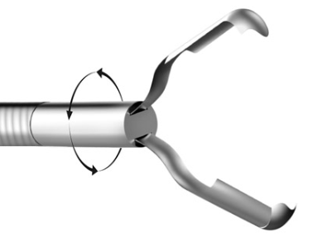
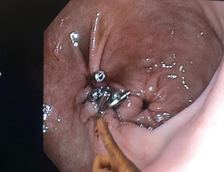
EGDS: positioning of endoscopic clip 2 of 20 mm 3 of 11 mm

Slide 6

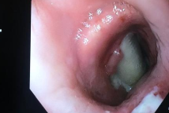
EGDS: VISION OF ENDOTRACHEAL CANNULA

Slide 7
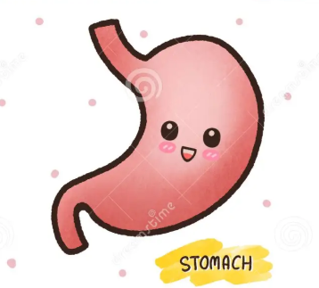
Case report
.
Improvement of all blood parameters and general conditon
19/01/2026: ct scan with oral contrast: negative for leakage
Positivity for Acinetobacter
The patient is still in intensive care department awake

Slide 8
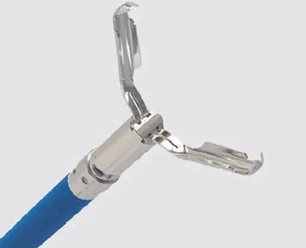
Conclusion
Endoscopic closure with clips can be a useful therapeutic alternative to re-surgery for delayed traumatic gastric perforation.

Slide 9




