Slide 1


Adult Intussusception
Two cases of inevitable open surgery:
when the point of view makes the difference
Bufano S.,Krizzuk D.,Presacco S.,Sammartino F.
Aurelia Hospital
Roma
X Maggio 2026

Slide 2

Adult intussusception
Overview
Intussusception in adults is uncommon.
Pediatric cases are usually idiopathic and responsive to non-operative reduction.
Differently, adult intussusception often requires surgery due to the high prevalence of neoplastic etiologies.
This presentation treats two clinical case reports.

Slide 3
Adult intussusception
Introduction
Intussusception: invagination of one segment of the gastrointestinal tract into an adjacent segment.
Incidence: 5%, representing 1–5% of the causes of bowel obstructions.
The diagnosis is challenging due to nonspecific symptoms.

Slide 4
Adult intussusception
Pathophysiology
The invagination pulls mesentery along the bowel lumen, causing venous congestion, lymphatic obstruction, edema, ischemia and potentially necrosis.
Fixed elements, such as tumors, lipomas or postoperative adhesions, disturb normal peristalsis and facilitate this process.

Slide 5
Adult intussusception
Anatomic classification
Entero-enteric
Ileo-colic
Ileo-cecal
Colo-colic

Slide 6
Adult intussusception
Clinical Presentation
Pediatric intussusception → triad of symptoms: colicky abdominal pain, vomit and diarrhea also mixed with blood ad mucus.
In adult population symptoms are nonspecific and often chronic or intermittent: abdominal pain, nausea, vomiting, altered bowel habits (constipation or diarrhea), gastrointestinal bleeding (less common than in children), weight loss and rarely palpable abdominal mass.

Slide 7
Adult intussusception
Diagnosis
The intussusception in adults is often diagnosed in the emergency setting. For this reason, CT scan, with or without contrast, is the most commonly used imaging modality.
Management
In pediatric practice, non operative treatment is often sufficient for intussusception, and the surgery is considered the second line after air or contrast enema.
In adult, there aren’t universally accepted guidelines, and surgery is often the first line of treatment.

Slide 8
Adult intussusception – CLINICAL CASE 1
Presentation
A 68-year-old female presented with acute abdominal pain, bilious vomiting, and complete bowel obstruction with absence of stool and gas.
Physical examination: diffuse tenderness without peritonitis.
On blood examination: WBC14900 and PCR 0.46.

Slide 9
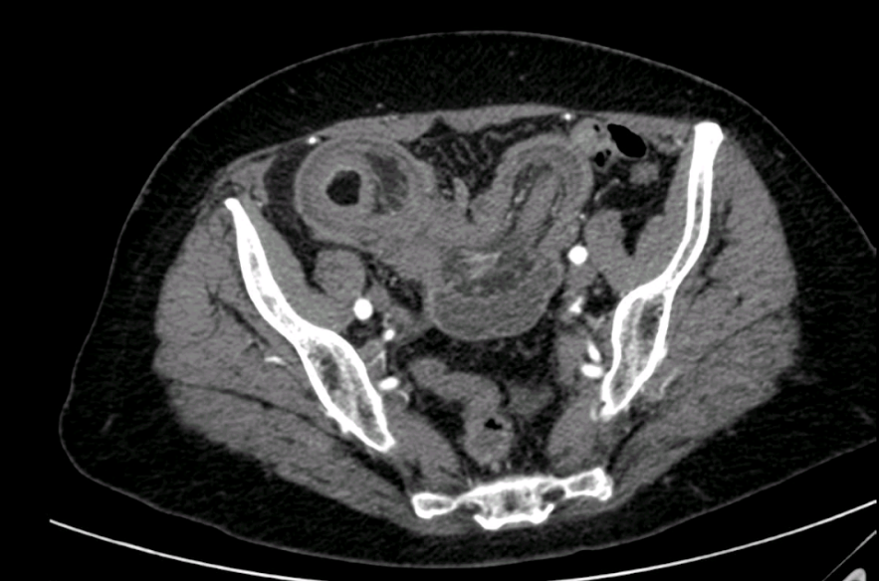
Adult intussusception - CLINICAL CASE 1
Diagnosis
CT imaging show an ileo-ileal intussusception extending 15-20cm.

Slide 10
Adult intussusception – CLINICAL CASE 1
Management
Exploratory laparoscopy confirmed non-reducible small bowel intussusception.
Laparoscopic reduction was unsuccessful and conversion to open laparotomy was performed.
On palpation, an ileal mass (about 2 cm) was noted, and a segmental resection was performed with an ileo-ileal anastomosis.
Histopathology confirmed the presence of an intestinal polyp.
The postoperative course was uneventful, and the patient remained asymptomatic at 6-month follow-up.

Slide 11
Adult intussusception – CLINICAL CASE 2
Presentation
A 46-year-old male reported intermittent abdominal pain from 15 days associated to diarrhea.
During physical assessment the abdomen was soft, mildly distended and non tender on palpation. No palpable masses were detected.
Laboratory tests revealed no leukocytosis and PCR 11.7.

Slide 12
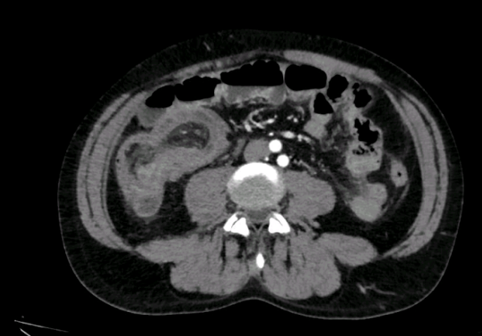
Adult intussusception - CLINICAL CASE 2
Diagnostic findings
CT scan report an internal hernia, involving the terminal ileum, with bowel wall changes suggestive of ischemia and associated fluid collection.

Slide 13
Adult intussusception – CLINICAL CASE 2
Management
Due to mismatch between clinical presentation and imaging, diagnostic laparoscopy was planned.
During the surgery erythematous and distended intestinal loops and ileo-colic intussusception were observed.
Laparoscopically, understand the extension of intussusception was impossible and conversion to open surgery was necessary.
An ileocolic resection was performed due to suspicion of malignancy.

Slide 14
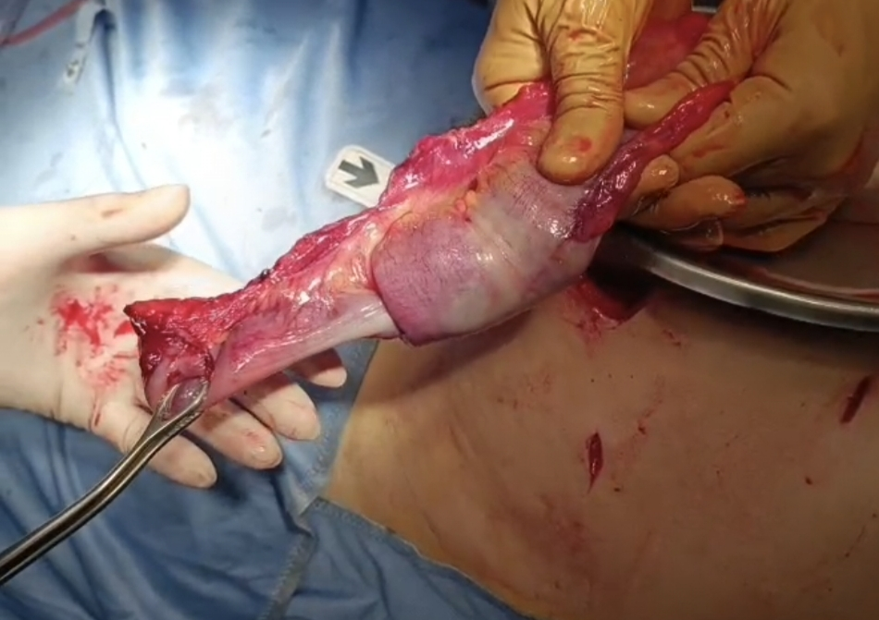
Histology showed an inflammatory fibroid polyp associated with acute and chronic inflammation of the wall and serositis.
Outcome
Post-operative course was uneventful.
The patient was discharge at III POD.

Slide 15
Adult intussusception
Discussion
Minimally invasive surgery should be preferred in abdominal surgeries, even in emergency settings of intussusception.
First approach: minimally invasive surgery.
Diagnostic laparoscopy can be used to confirm the diagnosis and attempt reduction of the intussusception.
BUT…The reduction is not always possible.

Slide 16
Adult intussusception
Conclusion
Minimally invasive approaches remains the first line of treatment but may have some limitations in this cases of emergencies.
The open surgery is not a failure!

Slide 17
Adult intussusception
References
T Chand J, R R, Ganesh MS. Adult intussusception: a systematic review of current literature. Langenbecks Arch Surg. 2024 Jul 31;409(1):235. doi: 10.1007/s00423-024-03429-2. PMID: 39085533.
Azar T, Berger DL. Adult intussusception. Ann Surg. 1997 Aug;226(2):134-8. doi: 10.1097/00000658-199708000-00003. PMID: 9296505; PMCID: PMC1190946.
Lu T, Chng YM. Adult intussusception. Perm J. 2015 Winter;19(1):79-81. doi: 10.7812/TPP/14-125. PMID: 25663210; PMCID: PMC4315384.
Demirkan A, Yağmurlu A, Kepenekci I, Sulaimanov M, Gecim E, Dindar H. Intussusception in adult and pediatric patients: two different entities. Surg Today. 2009;39(10):861-5. doi: 10.1007/s00595-009-3979-8. Epub 2009 Sep 27. PMID: 19784724.
Korkmaz O, Yilmaz HG, Taçyildiz IH, Akgün Y. Erişkinlerde invajinasyon [Intussusception in adults]. Ulus Travma Acil Cerrahi Derg. 2009 Mar;15(2):154-8. Turkish. PMID: 19353318.
Sun M, Li Z, Shu Z, Wu Q, Liu X. Adult intussusception: a challenge to laparoscopic surgery? PeerJ. 2022 Nov 30;10:e14495. doi: 10.7717/peerj.14495. PMID: 36518277; PMCID: PMC9744142.
Kang S, Lee SI, Min BW, Lee TH, Baek SJ, Kwak JM, Kim J, Kim SH, Kim JS, Ji WB, Um JW, Hong KD. A multicentre comparative study between laparoscopic and open surgery for intussusception in adult

Slide 18



Thank you for your kind attention!

