Slide 1
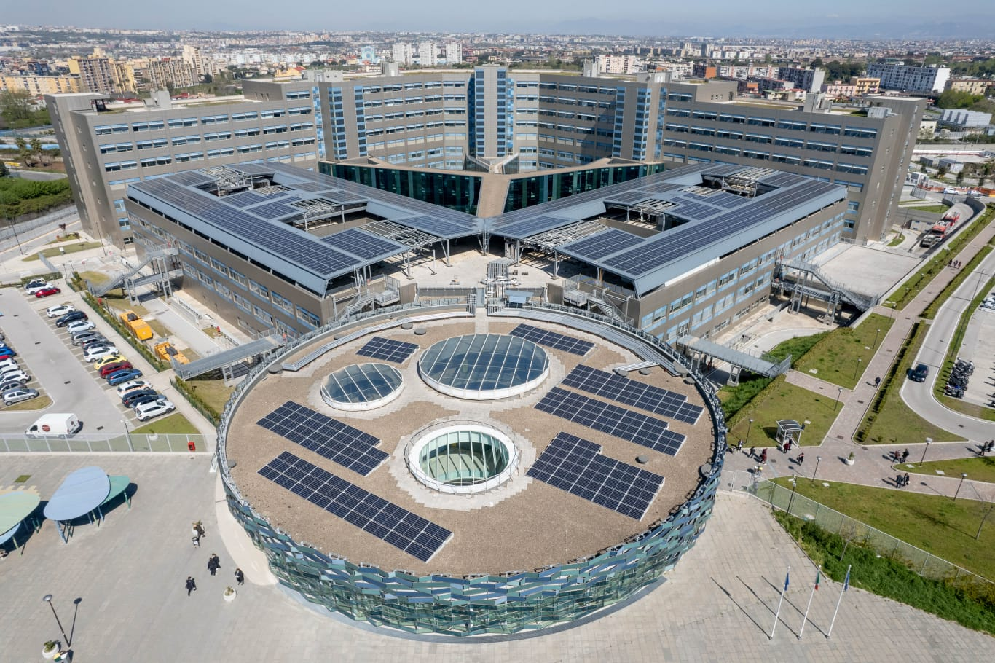
U.O.C. DI CHIRURGIA GENERALE E D URGENZA DELL OSPEDALE DEL MARE
DIR. M.F. ARMELLINO
DOTT. E. MARZULLO -DOTT. A. TRAVAGLINO -DOTT. G. MARTE

Slide 2
Patient with volvulus by acute divertiCulitis of small bowel.
Case report

Slide 3
Case report
An 70-year-old male was trasported by air ambulance from another hospital to our Department of General Surgery with a diagnosis of volvolus of the small bOWEL
pain started 12 h before and gradually increased in the right abdominal quadrants. It was accompaIned by nausea, no reported vomiting.
The patient was hemodynamically stable, a preoperative computed tomography(CT) scan was performed, revealing evidence of high-grade closed loop small bowel obstruction and associated a reduced vascularization of the superior mesenteric vein and vortical course

Slide 4
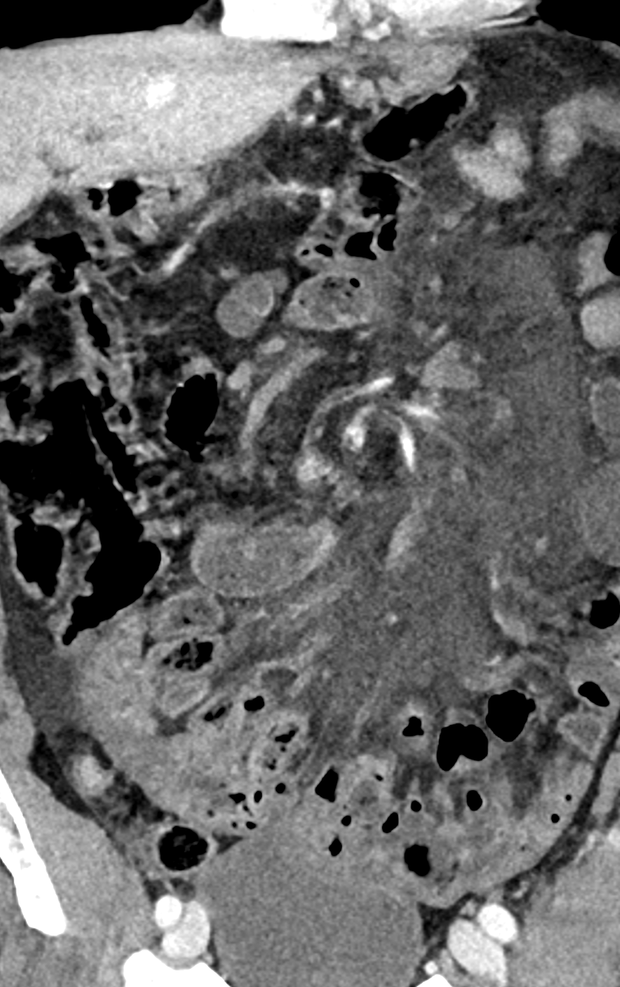
preoperative computed tomography(CT)
revealing evidence of high-grade closed loop small bowell obstruction and associated a reduced vascularization of the superior mesenteric vein and vortical course

Slide 5
Urgent surgery
The endocavitary exploration highlighted a small bowel obstruction from a proximal jejunal volvulus around the mesentery caused by an adhesion for an inflamed diverticulum in a patient with Small intestine diverticula. However, no intestinal resection was necessary because after manual deTorsion the small bowel had NO signs of necrosis. the inflamed diverticula of the proximal jejunum of 3 cm in diameter was resected .

Slide 6
discussion
Jejunal diverticulosis has been described in the literature as a cause of small bowel obstruction
Our case was characterized by a small bowel obstruction from a proximal jejunal volvulus around the mesentery caused by an adhesion for an inflamed diverticulum.

Slide 7
References:
1 Kassahun WT, Fangmann J, Harms J, Bartels M, Hauss J. Complicated small-bowel diverticulosis: a case report and review of the literature. World J Gastroenterol 2007; 13: 2240-2242
2. Zhang ZB, Gu C. Multiple jejunal diverticula causing intestinal obstruction. Indian J Med Res. 2015;142(1):97
3. Luitel P, Shrestha BM, Adhikari S, et al. Incidental finding of jejunal diverticula during laparotomy for suspected adhesive small bowel obstruction: A case report. Int J Surg Case Rep. 2021;85:106268
4. Lee RE, Finby N. Jejunal and ileal diverticulosis. AMA Arch Intern Med. 1958;102(1):97-102

