Slide 1
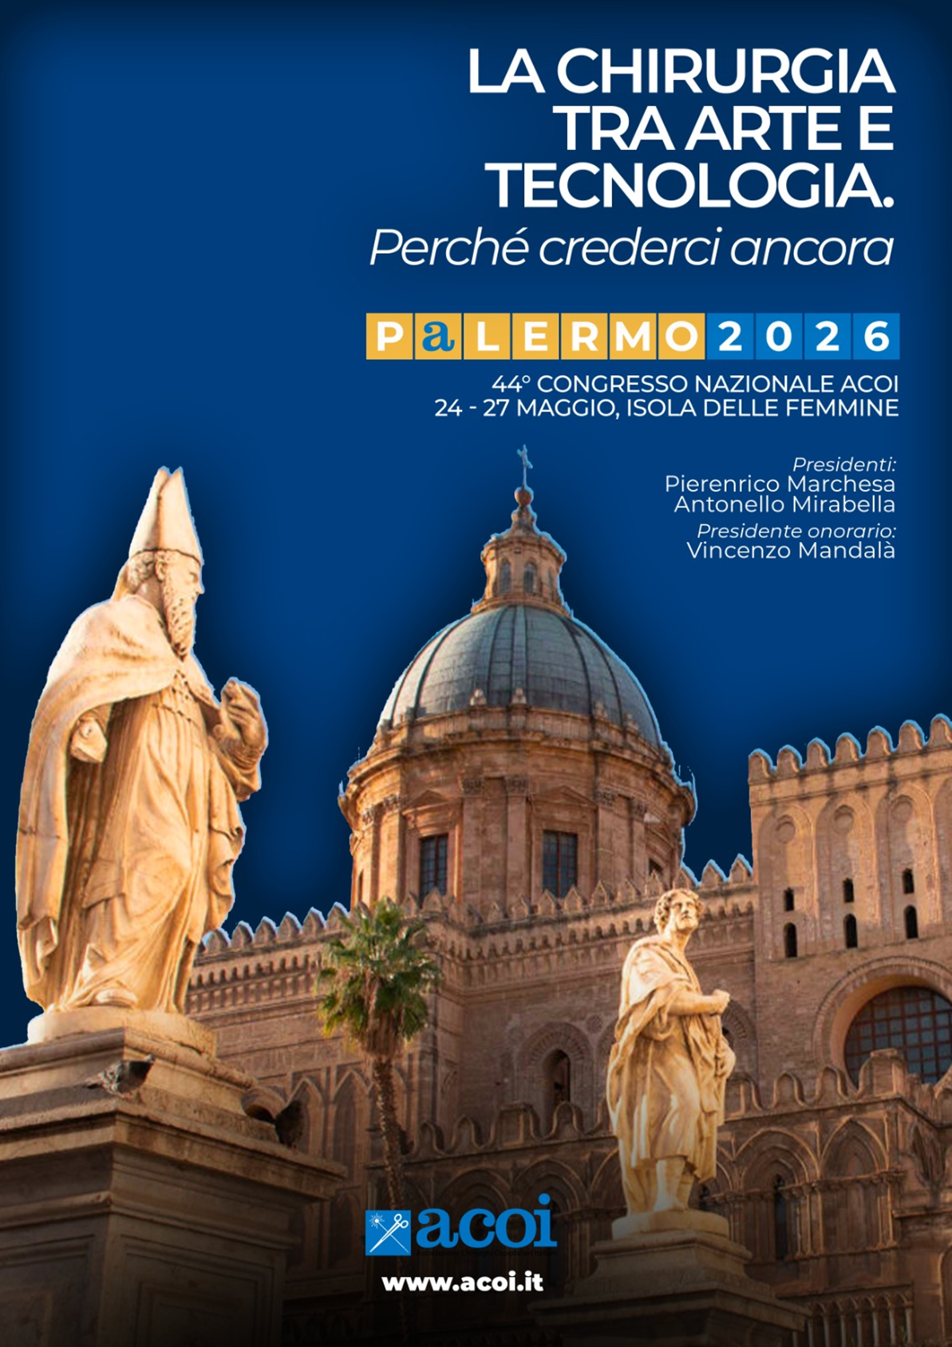

An unexpected post-endoscopy biopsy outcome, complicated by hemoperi-toneum: a massive intramural duodenal hematoma (m-IDH) causing upper gastro-intestinal (GI) obstruction..
Noemi Zorzetti, MD, PhD
U.O.C. Chirugia Dipartimentale
C.A. Pizzardi Ospedale Maggiore e
Costa Ospedale Alto Reno Terme,
AUSL Bologna
X Maggio 2026

Slide 2

An unexpected post-endoscopy biopsy outcome, complicated by hemoperi-toneum: a massive intramural duodenal hematoma (m-IDH) causing upper gastro-intestinal (GI) obstruction.
Aims: Massive intramural duodenal hematoma (m-IDH) is a rare entity due to trauma, spontaneous causes, post-procedural’s complications or underlying medical conditions so the therapy could be different. The aim of this study is report an infrequent clinical case e and review of the current literature.
Methods: We report a case of a 25-year-old man that was admitted to emergency department for mild abdominal pain and vomiting episodes. The patient reported to be under gastroenterological investigation of a suspected case of celiac disease and to have performed an esophagogastroduodenoscopy (EGDS) with biopsy two days before the admission. The first imaging, with abdominal ultrasound, showed a > 10 cm space-occupying lesion (SOL) in epigastrium. The CT-scan showed important gastrectasia and a condition of massive intramural duodenal hematoma (m-IDH) (20x8x5 cm) with duodenal compression and jejunal distension; a little contrast blush was encountered into the hematoma [Fig 1]. A close follow-up policy was adopted so the patient repeated a CT-scan after 24 hrs finding the presence of hemoperitoneum and a dimensional increase of the hematoma, with a complete compression of the duodenal lumen. An emergency EGDS was performed without experiencing active bleeding but a complete ob-struction of the lumen, not passable with the endoscope [Fig 2]. Considering the recovery in a third level hospital, a conservative treatment was conducted with success. Results: In our case report, conservative treatment was conducted with success. The American Association for the Surgery of Trauma (AAST) injury scale for the duodenum is a valuable support for assessing the severity of the injury and it is a helpful tool in clinical decision-making.
Conclusion(s): Intramural hematoma of the duodenum is a rare condition and its etiologies can be categorized into external injury (such as trauma), internal injury (iatrogenic lesion such as endoscopic procedure and/or biopsy) and spontaneous (such as overdose of anticoagulant agent in-take or spontaneous for real. According to the existing data, children are more affected than adults [Table 1]. Surgery should be performed as less as possible.

Slide 3
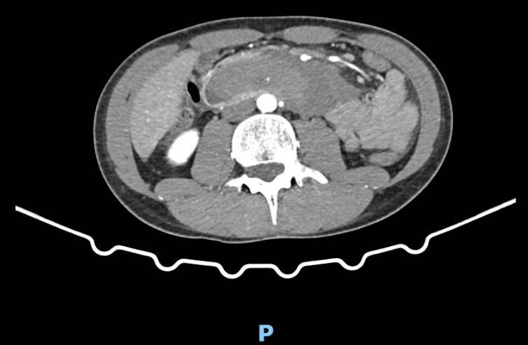
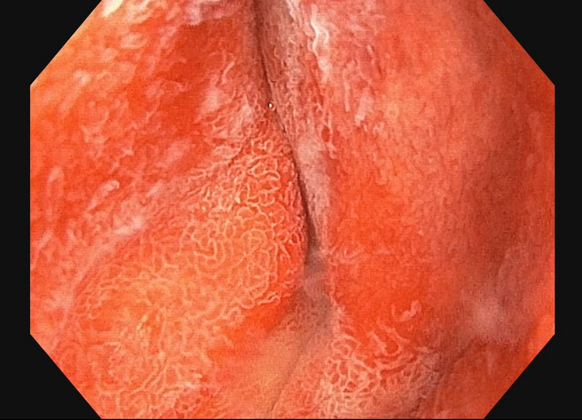
An unexpected post-endoscopy biopsy outcome, complicated by hemoperi-toneum: a massive intramural duodenal hematoma (m-IDH) causing upper gastro-intestinal (GI) obstruction.
Fig 1. CT-scan contrast blush.
Fig 2. EGD showing complete obstruction of the duodenal lumen

Slide 4
An unexpected post-endoscopy biopsy outcome, complicated by hemoperi-toneum: a massive intramural duodenal hematoma (m-IDH) causing upper gastro-intestinal (GI) obstruction.
Table 1. Aspects of IDH etiology, symptoms, diagnostic imaging and treatment in young and older populations.
 | Main causes | Symptoms | Diagnosis | Treatment | Follow-up
Pediatric/young population (< 30 yrs-old) | Trauma, endoscopic procedures, fragile patients, spontaneous | Nonspecific GI symptoms, nausea/vomiting, intestinal obstruction | US, CT-scan, MRI | NOM, embolization, endoscopic/percutaneous/MI surgical decompression and drainage, surgical emergency procedures if NOM fails or to treat lesions to other organs or IDH complications | US, MRI
Adult/older population | Trauma, anticoagulant oral intake, endoscopic procedures, pancreatic diseases, duodenal ulcers, tumors/chemotherapy, coagulopathy/thrombocytopathy, fragile patients, spontaneous | Nonspecific GI symptoms, nausea/vomiting, intestinal obstruction, hematemesis very rare | US, CT-scan, MRI | NOM, embolization, endoscopic/percutaneous/MI surgical decompression and drainage, LAMS, surgical emergency procedures if NOM fails or treat lesions to other organs or IDH complications | US, CT-scan

Slide 5




