Slide 1


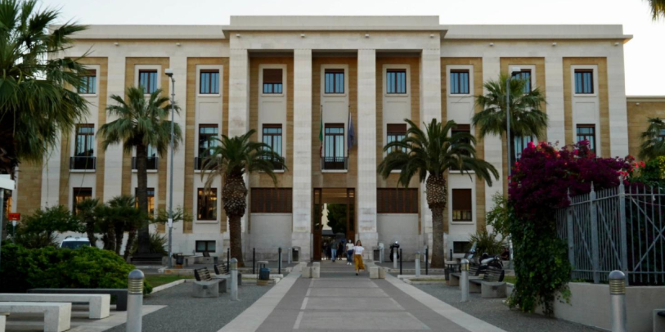
FOURNIER PERINEAL GANGRENE IN SUPER OBESE PATIENT. CASE REPORT AND REWIEW OF LITERATURE
Dr. P. N. M. Sallustio, Dr. W. Lavermicocca, Dr.ssa Miccoli M., Dr. De Luca M.G, Dr.ssa Puglisi G.,Dr. Di Canosa M.,Prof.F.Prete, Prof M. Testini
Università degli Studi di Bari “A. Moro” – Regione Puglia
Azienda Ospedaliero – Universitaria Consorziale Policlinico di Bari
Unità Operativa Complessa di Chirurgia Generale Universitaria “V. Bonomo”
Direttore: Prof. Mario Testini
24/27 maggio 2026

Slide 2


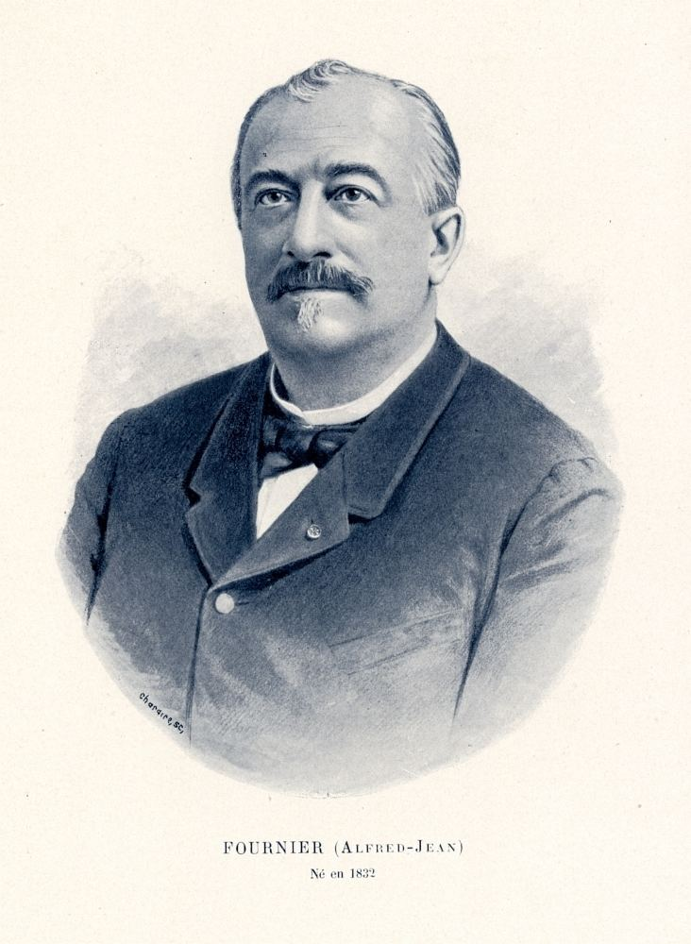

Fournier’s Gangrene (FG) is a soft tissue infection characterized by rapid tissue necrosis of the perineum, genitalia, due to a polymicrobial infection. This clinical situation causes thrombosis of subcutaneous vessels, with tissue ischemia, superinfection and necrosis; it appears usually in immunocompromised patients with diabetes, obesity, and malignant neoplasms. Immediate start of ampium spectrum antibiotics, aggressive management of comorbidities, and urgent surgical debridement remain the main treatment to decrease the morbidity and mortality.
We report herein a case of a super obese patient that cames to our attention for emergency perianal gangrene.

Slide 3

Case report
A female patient of 62 yeard was admitted to our department for a FG of the perineal right part. She was obese 198 kg with diabetes and cought and ipertension treated with medication. At the arrive in hospital she presented pain of the perianal region fever and 24.000 white cells counts with 250 PCR temperature 39.0 degrees. She was admitted in the department of Plastic Surgery and than transferred to our department of General Surgery.
The physical examination at the emergency room of the perianal region, revealed an area of necrosis, extended laterally from the left gluteus to the inferior part of the vagina for about 10 cm.

Slide 4
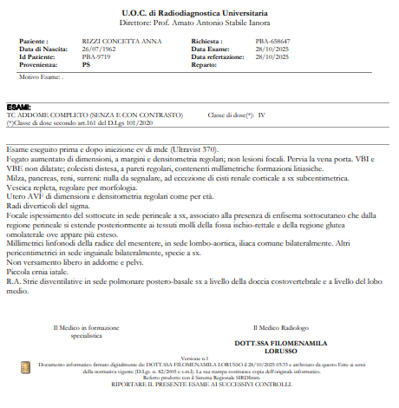

CT SCAN

Slide 5
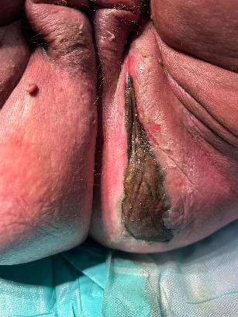

Clinical appareance

Slide 6
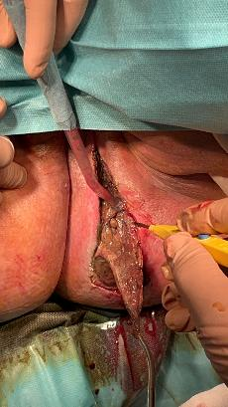
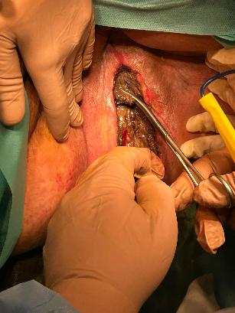
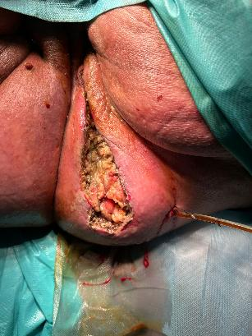
Surgical necrosectomy e positioning of drainage

Slide 7
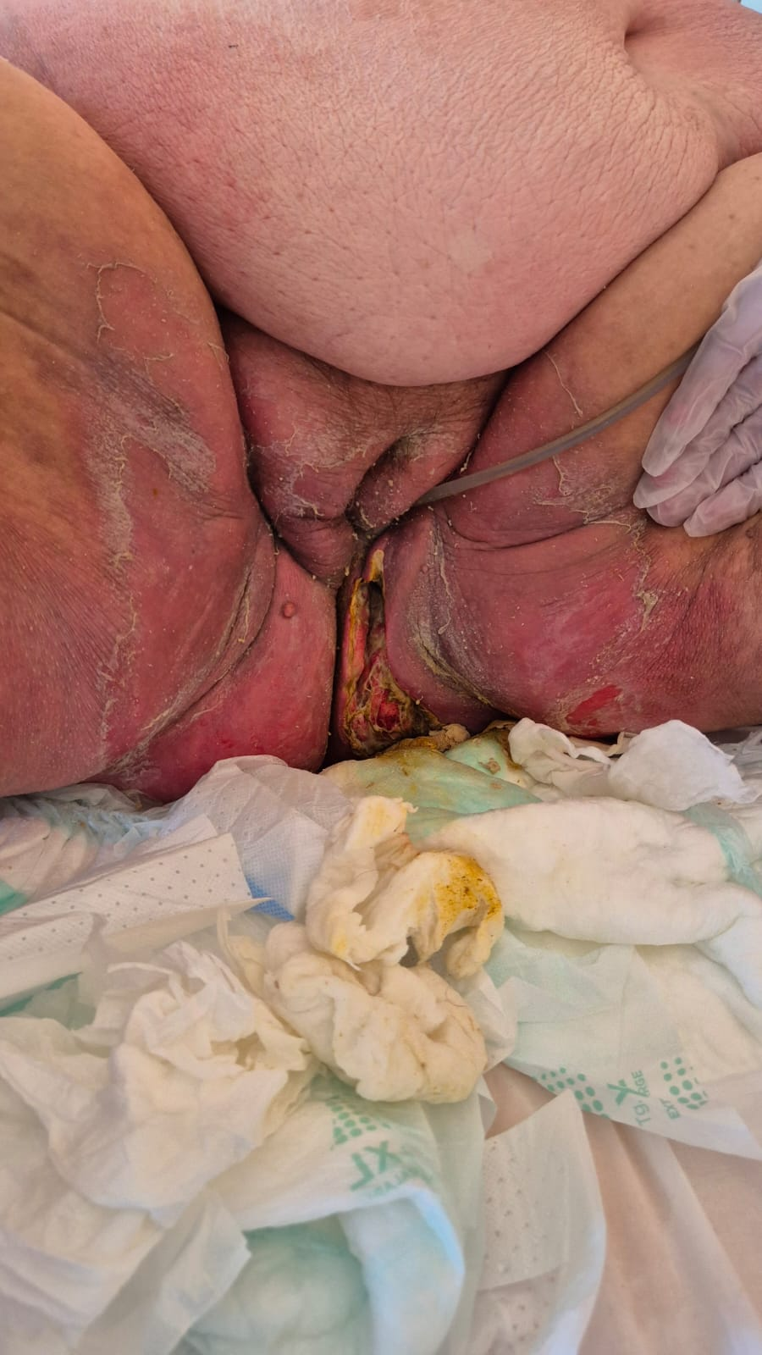
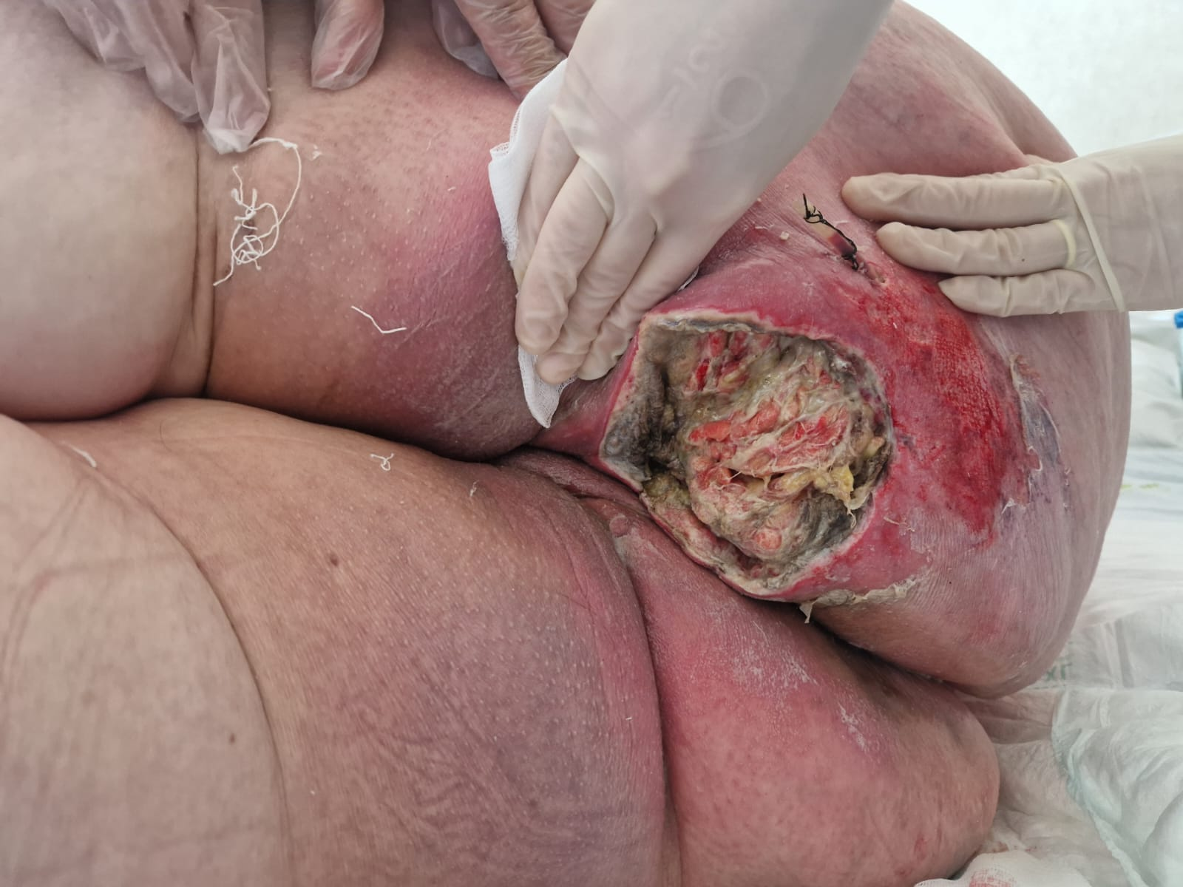
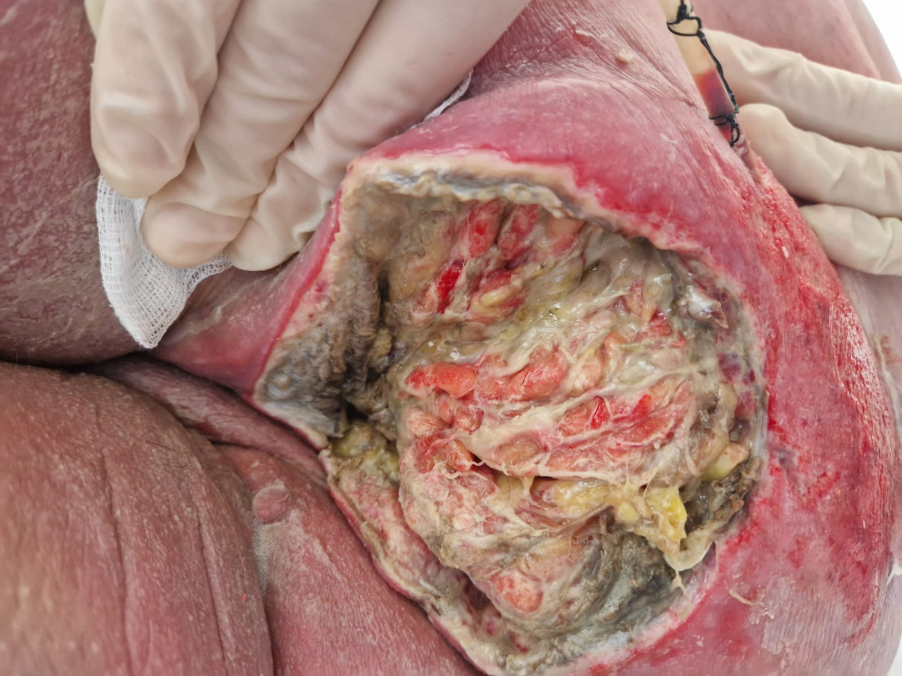

Slide 8
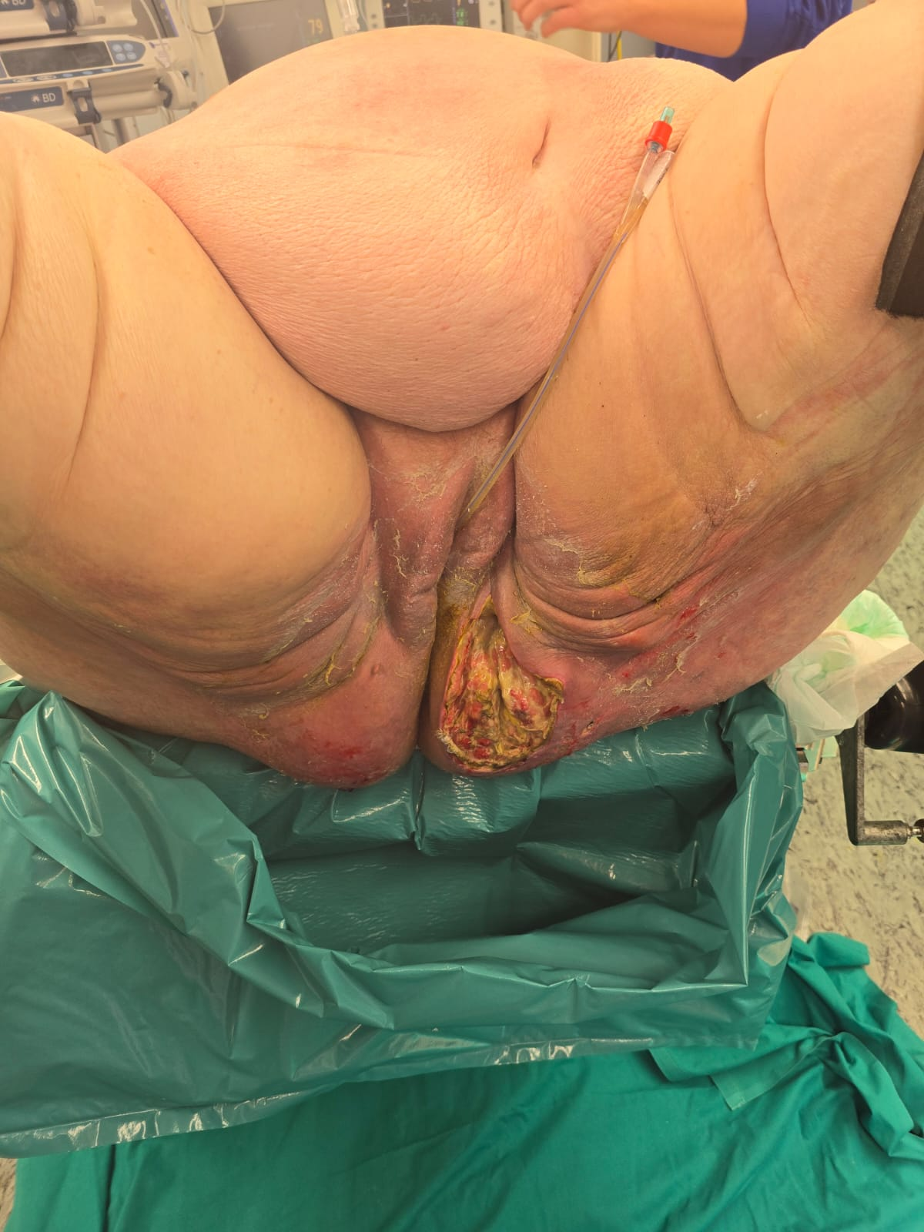
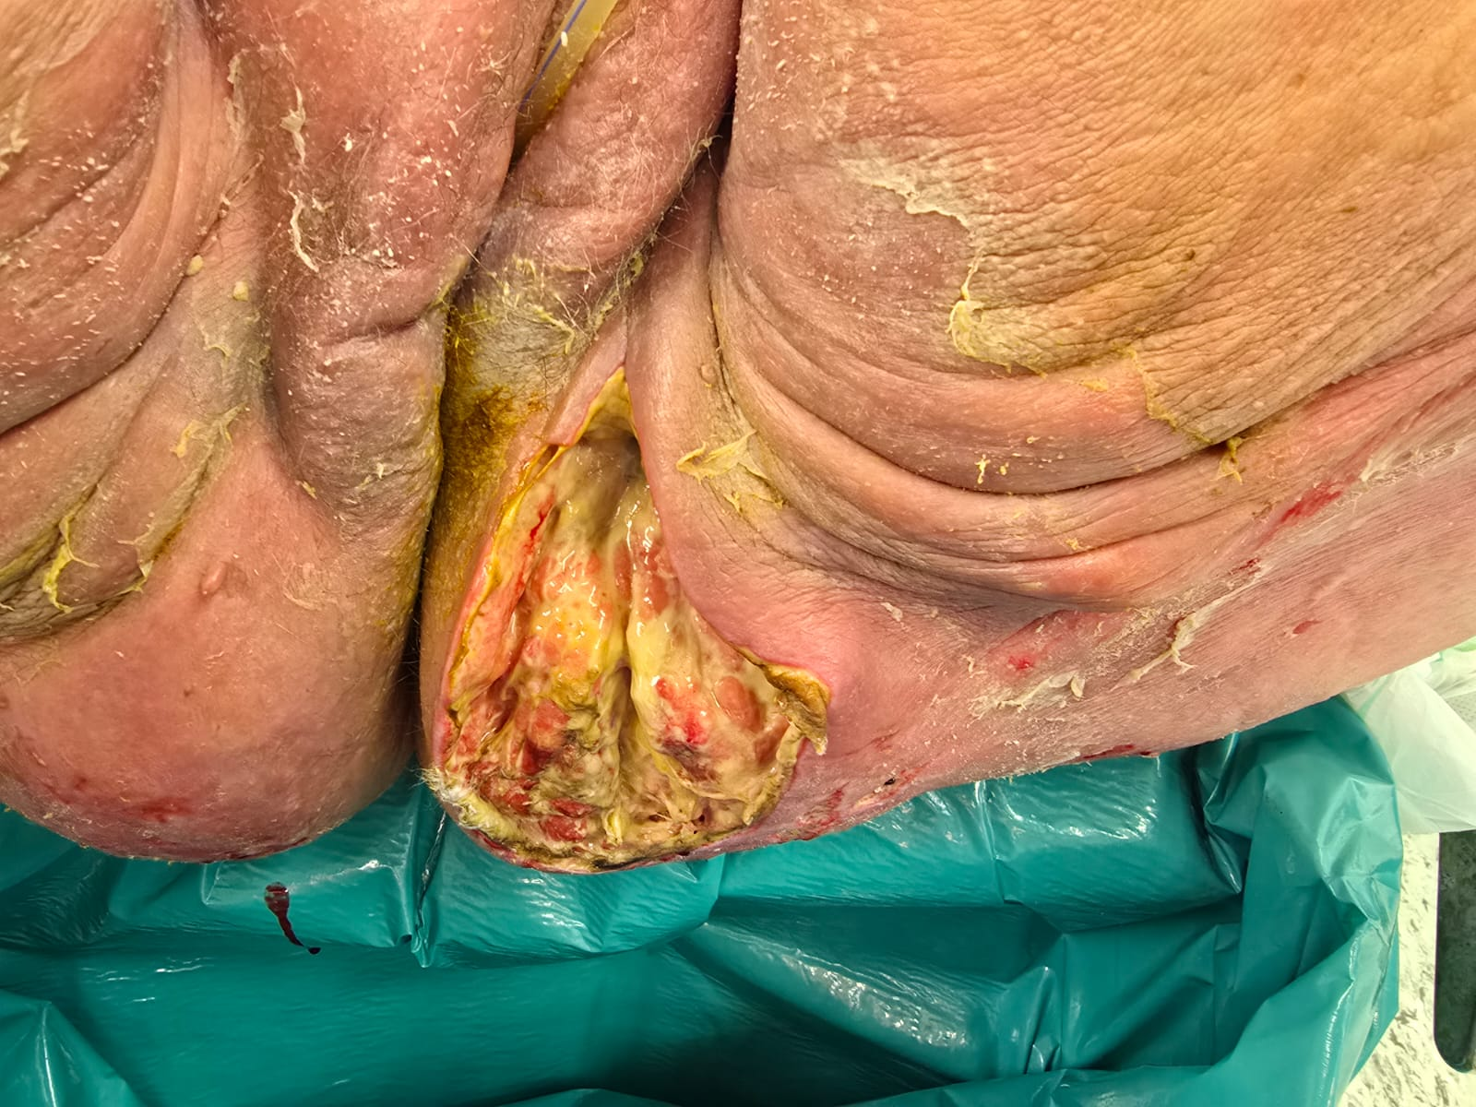
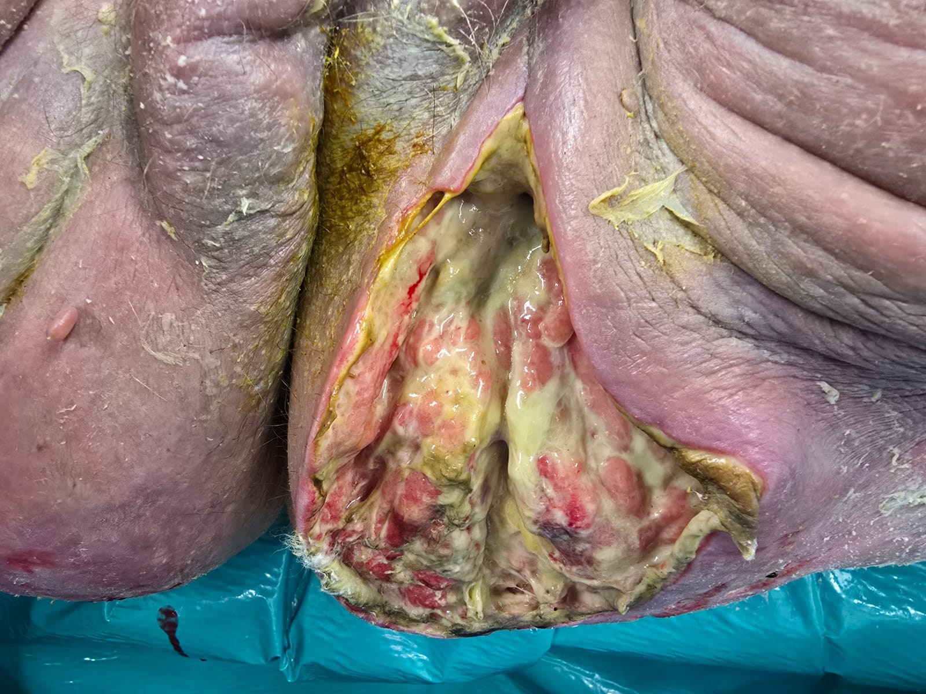
Reintervention after 5 days

Slide 9
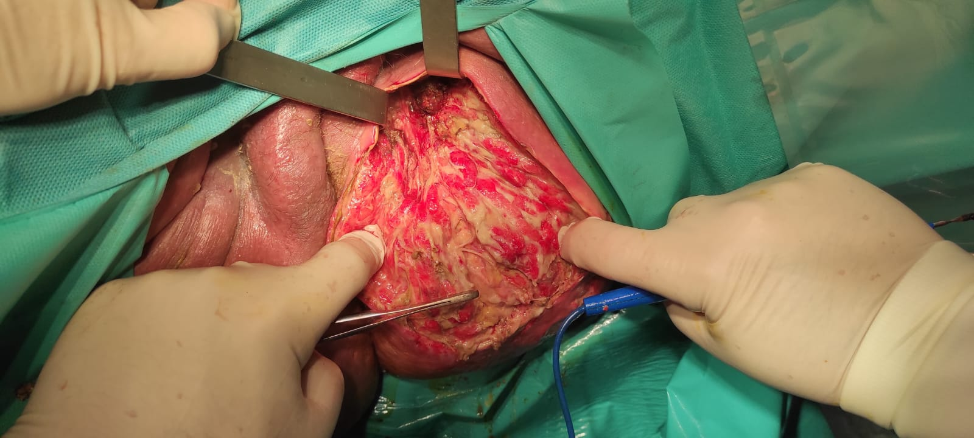
After VAC therapy
Each day she was medicated with improvement in healing of the wound . Many tc scan were performed to confirm the improvement of the healing of the perineal situation. After 45 days all the blood examination were normal but the patient as not able to stand up also with the help of physiotherapy and the patient was discharged from general surgery after consult with Internal Medicine also if further investigation had been proposed .

Slide 10
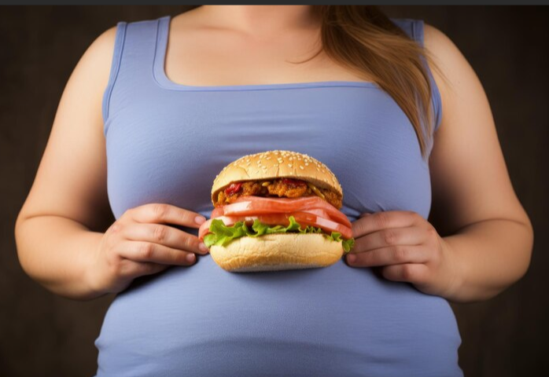

Discussion
It is a rare clinica feature, especially in women; the reported incidence is 1.6/100,000 of the male population with male cases outnumbering female cases at a ratio of 10:1 and the highest incidence is persons aged 50 to 70 years.
Risk factors include diabetes mellitus, alcohol abuse, hypertension, renal and hepatic failure, obesity, smoking, immunodeficiency diseases, and preexisting injury.Patients usually have a BMI > 30 or higher .
Each 10 people affected of FA , six of them die and for this early diagnosis is mandatory for contrast the deterioration of the general state of the patient. Science-based evidence and empirical statistics reveal a mortality rate of 24% to 34% on average among affected patients . Obesity is a highly predisposing factor leading to necrotizing fasciitis

Slide 11
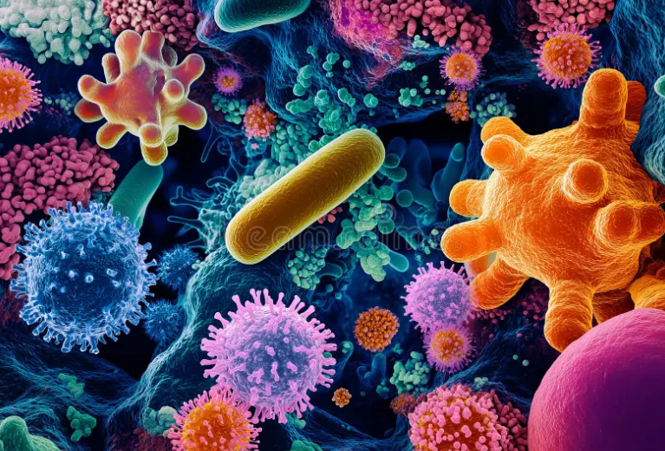
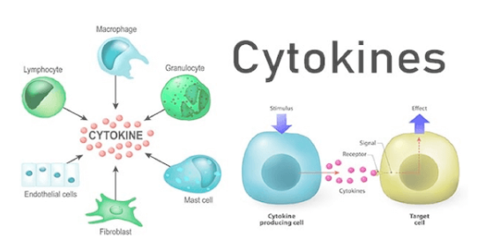
Diabetic patients have an increased incidence of Fournier’s gangrene due to their immunosuppressive state, poor wound healing, defective phagocytosis, and existing small vessel disease . According to Lira et al., diabetic patients with Fournier’s gangrene are found to have a higher mortality rate than non-diabetic patients at 71.9% versus 44.6%
The infection is polymicrobial in more than 80% of the cases.Multiple bacteria (aerobic and anaerobic) act in synergy and disseminate in the region, leading to tissue necrosis (Tang et al., 2015; The most commonly isolated micro organisms are those normally found in the perineum and genital organs, including Escherichia coli, Klebsiella pneumonia, Bacteroides fragilis, and Staphylococcus aureus Some fungal infections have also been reported
Sepsis initiates the cytokine cascade leading to the damage of the endothelium, which activates thromboplastin, and coagulation cascade with inhibition of fibrinolysis and the formation of disseminated microthrombosis of vessels of teh the fascia. In addition, damage to the endothelium leads to extravasation of the liquid part of the blood, swelling of tissues, leukocyte infiltration, all leading to the ischemic necrosis of the fascia

Slide 12


Fournier treatment depends on different factors and consists of emergent surgical resection of devitalized tissues, parenteral antibiotic coverage, intense clinical hemodynamic support, and resuscitation with fluids
Comorbidities play an important role in determining the survival of FG patients. Tenório et al. indicated that diabetes, but not hypertension, was significantly associated with non-survivors when compared to survivors
Lin et al 39 developed the simplified Fournier Gangrene Severity Index (sFGSI), a three variable scoring system that can predict mortality and categorize patients as high-risk or low-risk. In sFGSI high-risk patients, timing of intervention dramatically decreased mortality from 68.8% in those with late intervention to 23.8% in those with early intervention.

Slide 13
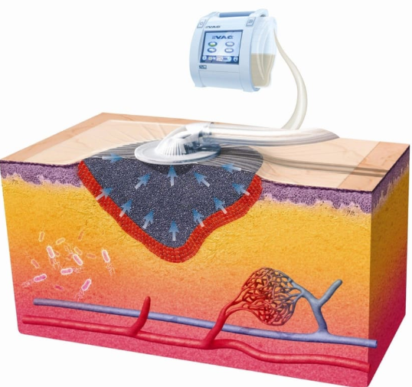

Negative pressure wound therapy and wound VAC therapy are often used for treatment after surgical debridement to obtain clening and wounding also if the position of the perineum is not confortable for the positioning of the device. Wound VAC therapy helps increase blood supply leading to increased migration of inflammatory cells to the wound region, promoting healing and extended debridement.
Multiple surgical procedures may be necessary to prevent recurrence of Fournier’s gangrene and often reconstructive surgery may be necessary.The main cause of death is sepsis, followed by organ failure due different species of aerobic and anaerobic bacteria.
Plasma exchange has been proposed as therapy by decreasing circulating inflammatory mediators in the blood. Comorbidities can be used as a determinant prognostic tool to predict FG mortality
Differential diagnosis in the early stages of Fournier gangrene should be performed with gangrenous balanitis in diabetics, and among women with gangrenous diabetic vulvitis, ulcerative and gangrenous forms of inguinal lymphogranulomatosis and acute ulcers of the genitals

Slide 14
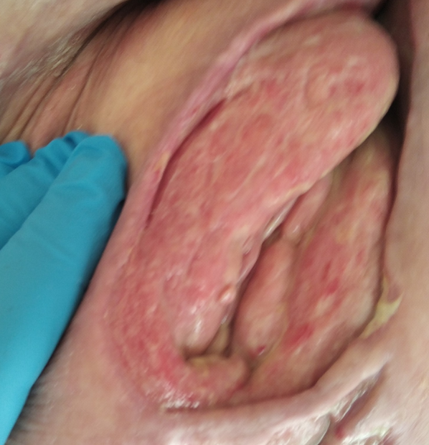
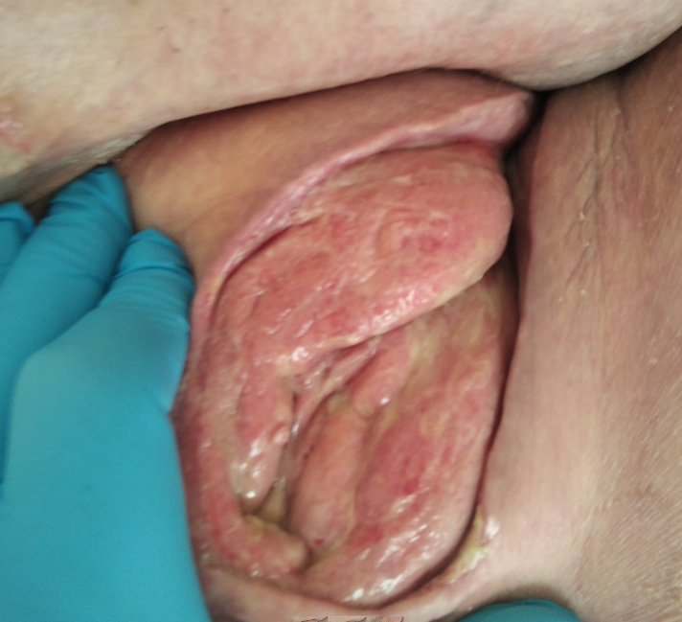
After 60 days

Slide 15

Fournier’s gangrene treatment is a surgical challenge often multidisciplinary , and must be treated by medical and surgical therapy. If diagnosed and treated early, mortality can be decreased. It requires a complete approach with fluid support, hydro-electrolyte resuscitation, antibiotic therapy, intensive care ospedalization in the first fase of the desease for monitoring laboratoristic parameters, and an aggressive surgical approach can improve the chance of survival of the patients. Plastic surgery tecniques are commonly used for reconstruction. The best option for reconstruction should rely on the surgeon’s expertise, patient preference, and available resources

Slide 16
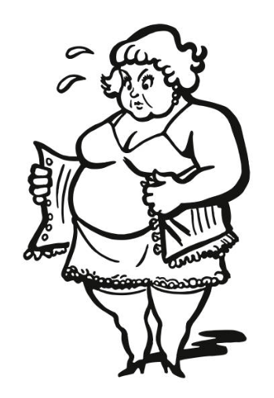
Lo sapevate che l'obesità è un problema in rapida espansione? (Lopezzone)

Slide 17





